Slide 1
SaaS API Strategy
Josh Morris Manager, Product Management SailPoint
Kirby Fitch Sr. Product Manager SailPoint

Slide 2
API Strategy
To empower our Developer Community to achieve greater value from our SaaS products faster through extensibility.
Examples of recent Feature / Functionality to support this strategy:
New, modern microservices built on an event-driven architecture.
2023 GOAL: Increase Public APIs by 3X
Event-driven architecture allows us to expose Event Triggers.
2023 GOAL: Increase Event Triggers by 3X
New features, including API Scoping and Configuration Hub.
2023 GOAL: Continued expansion of APIs with scopes and use cases for Config Hub

Slide 3
Impacts to Developer Community
Beta to V3 API Promotion
Deprecation of Non-Public APIs
Changes to back-end processes
Promotion Strategy for Beta APIs.
Guidance on use of Beta vs Production APIs.
What is being deprecated?
When will deprecation begin?
How to stay informed.
Real-time Attribute Sync.
Disabling 8am Refresh.

Slide 4
Beta to V3 API Promotion
IN PROGRESS
In response to the growing number of Beta APIs, we are making improvements to how we manage the lifecycle of Beta APIs.
Review of all Beta APIs and promotion of stable endpoints to V3.
If using a promoted Beta endpoint, start planning your migration.
Watch for announcements in Developer forum for updates.
FUTURE STATE
As this lifecycle matures, we will provide more clear definitions and expectations on Beta versus Production version APIs and how they should be used.
Beta APIs: Non-production, used to gather feedback prior to promotion.
Production APIs: No breaking changes, longer EOL timelines for deprecation.

Slide 5
Deprecation of Non-Public APIs
The detailed announcement and FAQ is available in the announcements section of our Developer forum.
developer.sailpoint.com/discuss
Why? SailPoint legacy APIs were designed for our internal use. These are being replaced by a newer set of publicly available APIs. All new SailPoint services use these new Public APIs. Use of these new APIs is required to get the benefits of our latest features and most performant services.
Non-Public API: Today, any API that does NOT start with /v3 or /beta is considered Non-Public and is being targeted for deprecation and EOL.
Deprecation: Marks API as obsolete and starts clock for EOL.

Slide 6
What to know...
List to be posted on Developer forum
Subscribe to List
Detailed announcement and FAQ available in the announcements section of our Developer forum.
developer.sailpoint.com/discuss
Stay informed by subscribing to this announcement. All updates will provide an automated notification.
As APIs are marked as deprecated, they will be added to this list, including EOL date and equivalent /v3, if applicable.
Subscribe to receive notifications when additional updates are made.
1st Priority: /cc APIs
2nd Priority: /v2 APIs
APIs that start with /cc are our top priority.
These must be EOL by 12/31/2023.
APIs that start with /v2 will have a 12-month EOL period from when each API is marked as deprecated.

Slide 7
Updates to Backend Processes
Kirby Fitch, Senior Product Manager

Slide 8
Real-Time Attribute Sync
Delivered

Slide 9
Real-Time Attribute Sync
Now
Then
Self-Service Sync
Syncing when Admin requests
Synced once / day
Sync Identity Changes
Syncing after identity events
Synced once / day
Overwrite Account Changes
Syncing after account events
Synced once / day
©2022 SailPoint Technologies Holdings, Inc. All rights reserved.
9

Slide 10
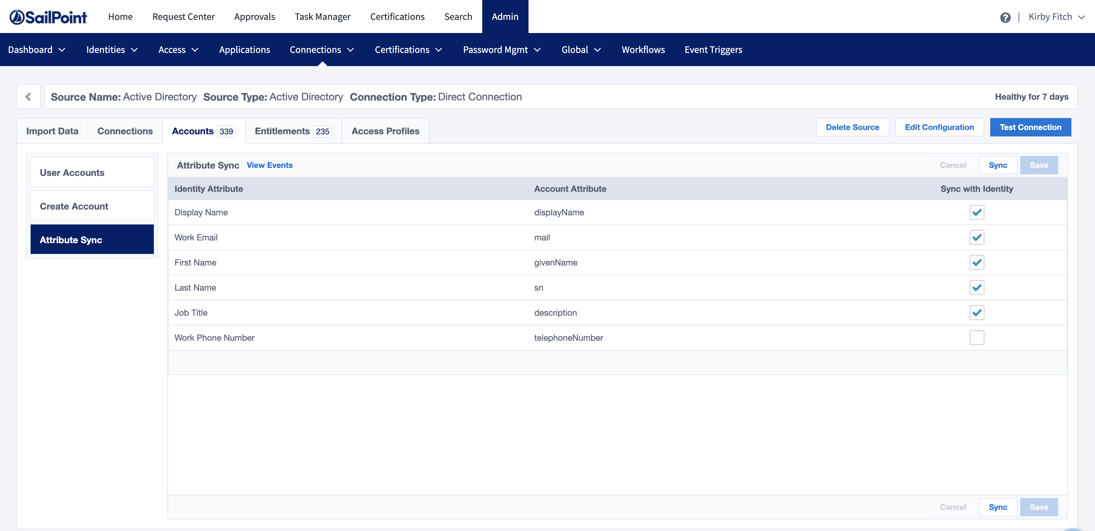
Self-Service Sync /sources/:id/synchronize-attributes
Admins apply config changes or retry sync errors
©2022 SailPoint Technologies Holdings, Inc. All rights reserved.
10

Slide 11
Sync Identity Changes
Detect Identity Attribute Change
Title: Product Manager
Evaluate Account Attribute
Job Title: Astronaut
Sync Identity Attribute
Job Title: Product Manager
IdentityNow syncs identity changes down to accounts
©2022 SailPoint Technologies Holdings, Inc. All rights reserved.
11

Slide 12
Overwrite Account Changes
Detect Account Attribute Change
Title: Professional Food Critic
Evaluate Identity Attribute
Job Title: Product Manager
Sync Identity Attribute
Job Title: Product Manager
IdentityNow overwrites changes to governed account attributes
©2022 SailPoint Technologies Holdings, Inc. All rights reserved.
12

Slide 13
Retire 8am Attribute Sync Job
Up Next

Slide 14
Retire 8am Attribute Sync Job
Admins have more flexibility End users' access requests and password changes provision faster
©2022 SailPoint Technologies Holdings, Inc. All rights reserved.
14

Slide 15
Discover and Correct Errors /search and /sources/:id/synchronize-attributes
Admins and Devs use search to find errors and sync when needed
©2022 SailPoint Technologies Holdings, Inc. All rights reserved.
15

Slide 16
Disable Scheduled Processing
Admins have complete flexibility after retiring 8am lifecycle checks
©2022 SailPoint Technologies Holdings, Inc. All rights reserved.
16

Slide 17
Thank you!

