Slide 1
Beyond Life-Cycle State to Multinomial
speaker: Cullen Landrum title: Advisory Solutions Consultant company: SailPoint

Slide 2
What will we chat about today
Each
With its own state
What do you do when life cycle state in IDN isn't enough, and you need to have a multinomial state.
But wait there's more.
How do you show changes over time in IDN? You can't change the internet clock, but you can show transitions
Many
Affiliations

Slide 3
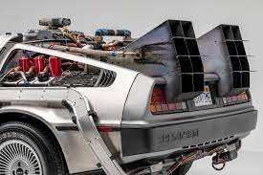
Description
In many industries, but especially in higher education, there is the requirement for multiple associations with the entity where a simple life cycle state is not enough to capture the various states that a user may have with the institution.
The goal is to describe and show how multiple affiliations or personas can be implemented in IDN. Being able to show changes over time is another associated use case.
The showcase will highlight how a simple time machine can be implemented.

Slide 4
First – What is a multinomial?
You roll a die ten times to see what number you roll. There are 6 possibilities (1, 2, 3, 4, 5, 6), so this is a multinomial experiment. If you rolled the die ten times to see how many times you roll a three, that would be a binomial experiment (3 = success, 1, 2, 4, 5, 6 = failure).

Slide 5
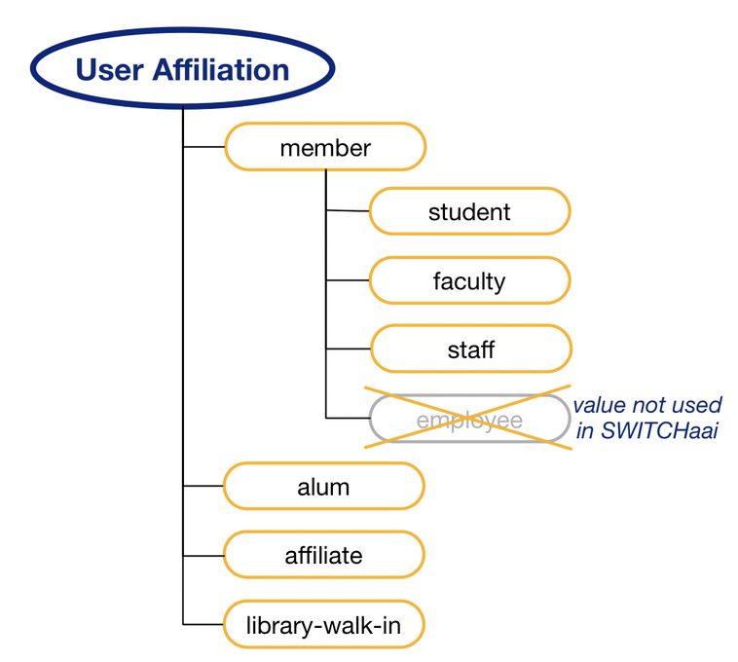
How does this relate to Life Cycle State?
In higher education there is a schema design called eduPerson and within there is eduPersonAffiliations and eduPersonPrimaryAffiliation
Each affiliation can have its own life-cycle state. A user can be an alumni that went back to school so a student while working so a student worker.

Slide 7
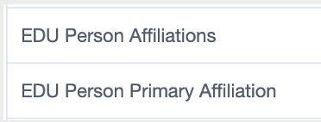
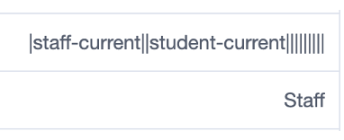
Calculate Affiliations
{
"id": "e03326b9-9aa2-4bca-aada-26899a1fb99a",
"name": "Get EduPersonAffiliations",
"type": "concat",
"attributes": {
"values": [
{
"attributes": {
"accountPropertyFilter": "(eduPersonAffiliation == \"faculty-current\")",
"attributeName": "eduPersonAffiliation",
"sourceName": "PeopleSoft HCM"
},
"type": "accountAttribute"
},
{
"attributes": {
"attributes": {},
"value": "|"
},
"type": "static"
},

Slide 8
Membership Criteria
eduPersonAffiliations is then used to assign membership to roles

Slide 9
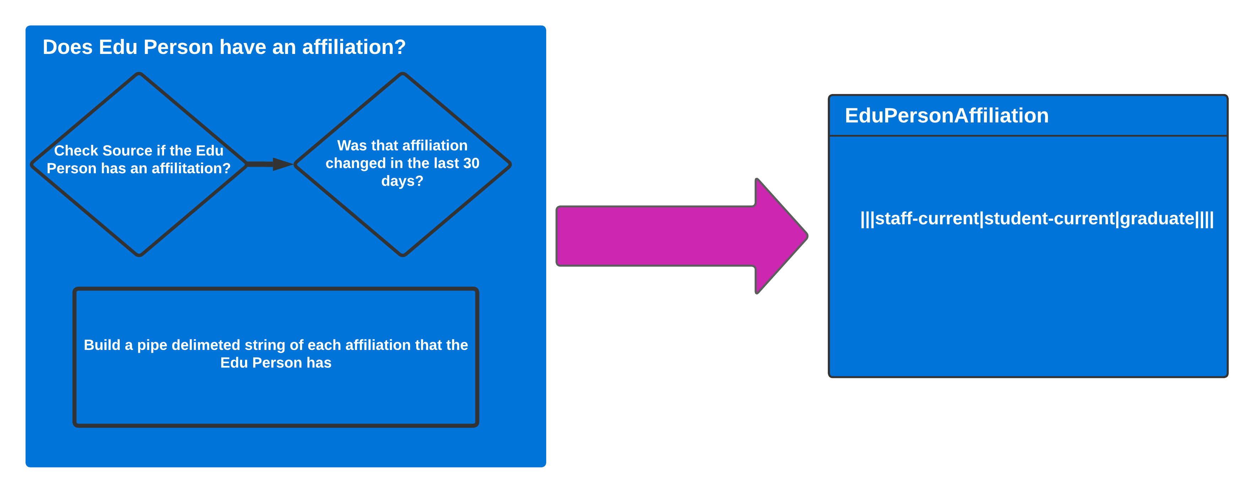

Slide 10
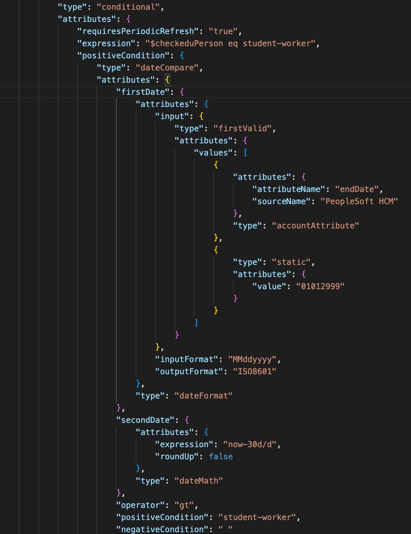
Let’s go back in time

Slide 11
Let’s see it
Demo time

Slide 12
Student
Staff
Affiliations
Faculty

Slide 13
Thank You!

Slide 14
No Students

Slide 15
Prospective Student
Student
Staff
Affiliations
Student-prospect
Faculty

Slide 16
Prospective Students Added

Slide 17
Current Student
Student
Student-worker
Staff
Affiliations
Student-current
Student-worker
Faculty

Slide 18
Let’s Look at Randy Barns

Slide 19
Now Randy Becomes a Current Student

Slide 20
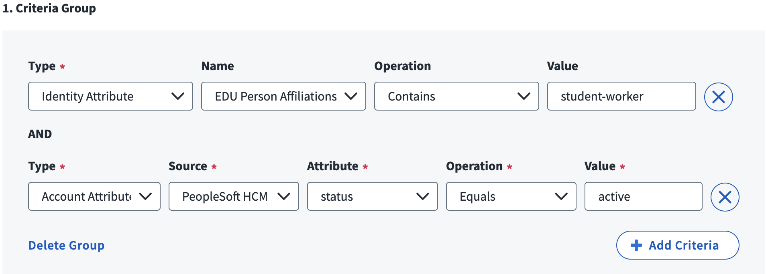
Now Randy Becomes a Student Worker

Slide 21
Randy No Longer Student Worker But retains Role for 30 days (after 15 days)

Slide 22
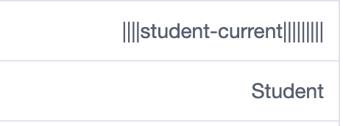
After 30 Days Student Worker Role Removed

Slide 23
Graduate
Student
Staff
Affiliations
Alumni
Faculty
Alumni

Slide 24
Student
Staff
Affiliations
Alumni
Faculty-current
Associate Professor
Faculty
Alumni

Slide 25
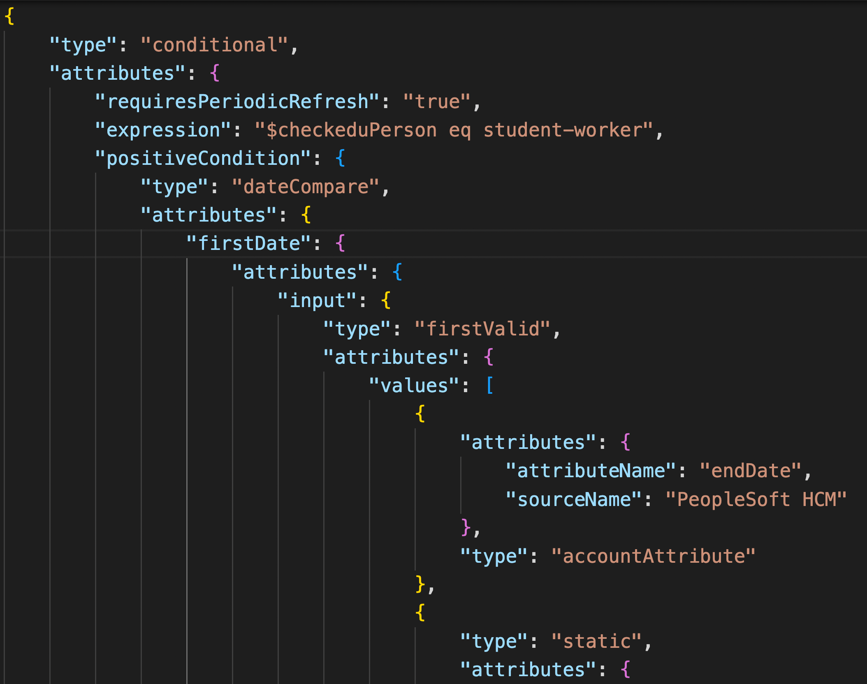

Slide 26
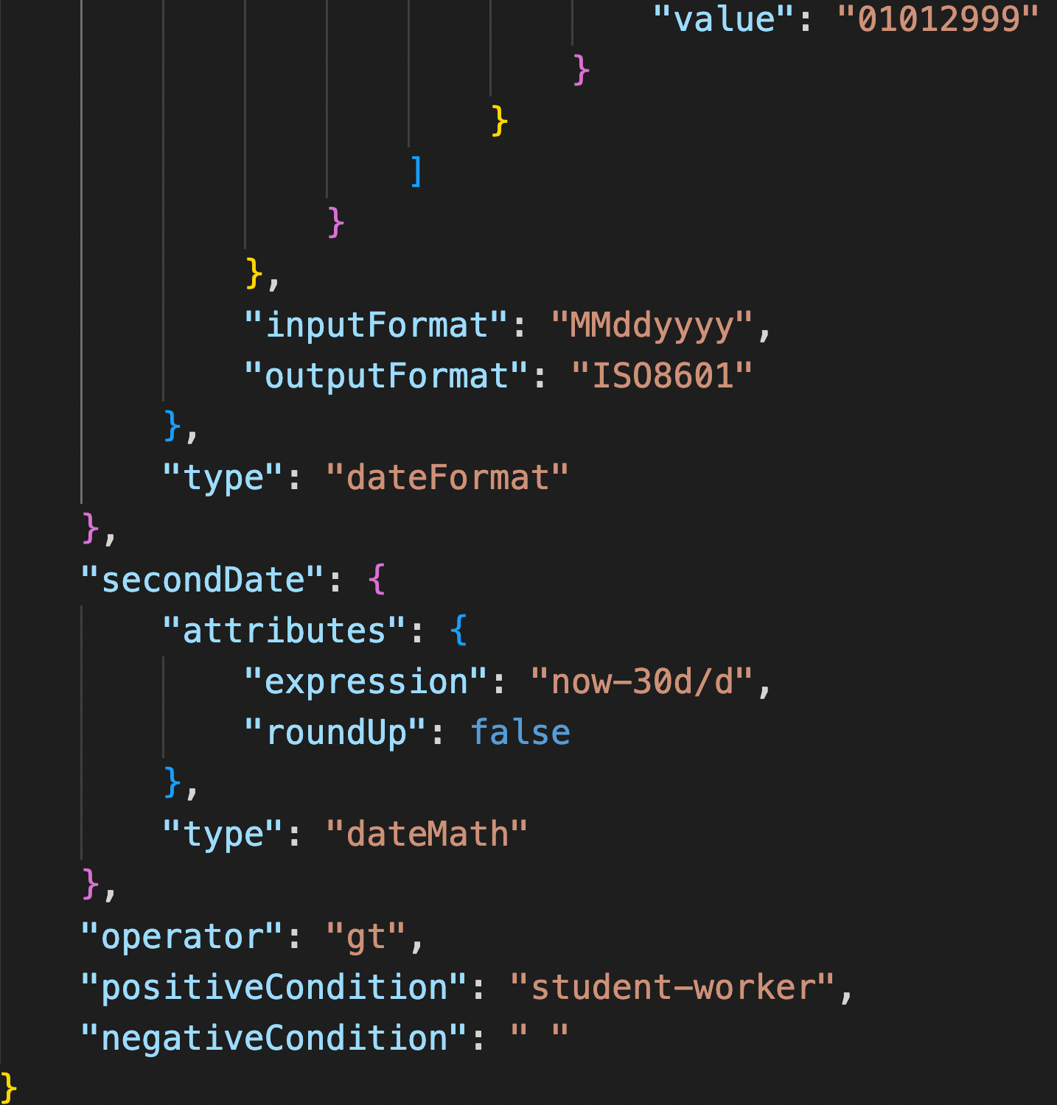

Slide 27
