Slide 1
Ungluing Sticky AttributeAssignments
Speaker: Brian Weigel title: Sailpoint IIQ Product Owner company: iC-Consult

Slide 2
Introduction to AttributeAssignments
What are they conceptually?
Entries created on an Identity to track entitlements, and stored in the Identity Preferences map under the “attributeAssignments” key
Can be “negative” (rare), which would prevent a specific assignment from occurring when it otherwise would
Example: A birthright role is revoked in an access review. That role will not re-assign and provision - even if the Identity still matches all the birthright role assignment criteria.
Tie an Entitlement on an Identity to a specific Application and Account
NOT IdentityEntitlements (but there often is a matching IdentityEntitlement)!
How does this tie into the IIQ Object Model?
Are of class sailpoint.object.AttributeAssignment, which is a sub-class of sailpoint.object. Assignment
Are the result of a provisioning plan executing an AttributeRequest
The AttributeAssignment class has a method to generate a complete AccountRequest for a given AttributeAssignment: toAccountRequest(acctReqOp, attrReqOp)

Slide 3
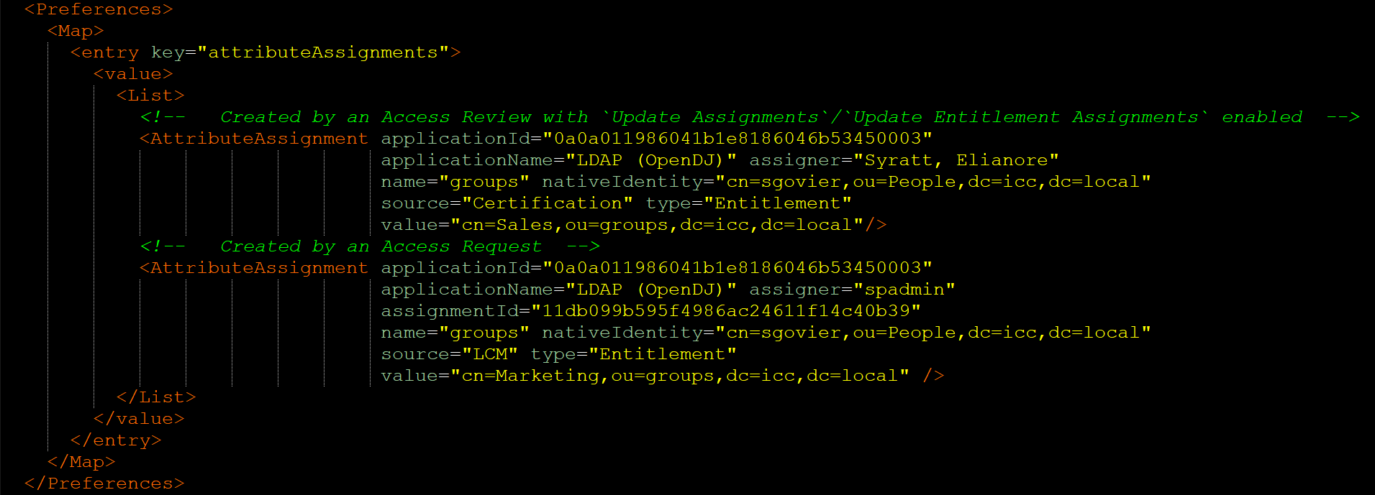
Anatomy of an AttributeAssignment

Slide 4
Why were they created/why do they exist?
Trace a specific entitlement’s existence on an account to either an Access Request or Access Review
Access Requests (IdentityRequest objects) and Access Reviews (Certification objects) are large
AttributeAssignments, being natively attached to the Identity object in its entirety, can maintain a record of an action long after the Certification or IdentityRequest that created it is archived or pruned
Attempting to resolve a source IdentityRequest or Certification for a given Entitlement’s existence on an Identity would require significant computation to resolve
Maintaining this information in a single object entry on the Identity itself negates the need for any related object lookups in many cases as the information natively present in the AttributeAssignment itself is sufficient
Simplifies the related-object lookup and retrieval by maintaining object names/ids
Intended to help reduce “Certification Fatigue”
Configuring certifications to exclude roles and “assigned” entitlements to focus only on “exception” entitlements would greatly reduce number of entitlements managers needed to review over time as more entitlements either get packaged into roles, or get passively “assigned” in reviews via the “Update [Entitlement] Assignments” option.

Slide 5
Could your provisioning woes be the result of AttributeAssignments?
Some examples:
Deleted accounts being recreated for termed users
Duplicate accounts being created (or attempting and failing) after the original account has been moved
Attempting to provision a non-existent entitlement if the entitlement has been deleted, moved, or renamed in the target application
This happens because the AttributeAssignment contains explicit references to the target account and entitlement native identity.
If either of those change in the target system, IIQ will attempt to provision the AttributeAssignment as-defined by what is contained in the AttributeAssignment itself.
In IIQ 8.3, “Active Directory Native Move/Rename Support” was added as a new feature. This should help mitigate a significant part of this problem by propagating DN changes in AD to other IIQ objects, but it is yet to be seen how effective this will be in practice regarding AttributeAssignments, and AD is not the only integration type that can suffer these kinds of issues.

Slide 6
So what makes these AttributeAssignments “sticky”?
AttributeAssignments are effectively static – Once they are created on an Identity, there are no pre-built system processes that periodically validate and update them based on system changes
Note: Many people assume that account/group aggregations and Identity refreshes will maintain these and update them when needed, but that is not OOB
The Refresh (when “Provision Assignments” is enabled) essentially generates AttributeRequests for all AttributeAssignments and sends it to the provisioner for execution, and relies on the provisioner plan compiler to “filter out” any generated AttributeRequests that already exist on the associated account in the created AccountRequest
AttributeAssignments can technically come from virtually any source that creates and executes a provisioning plan
The vast majority will generally come from either an Access Request or as the result of a Certification (as noted earlier)
AttributeAssignments will often be left on an Identity, even after termination, unless the Leaver workflow is designed and built to explicitly remove them upon termination

Slide 7
So how can we manage AttributeAssignments effectively?
Option 1: Ensure consistency is established and maintained
Ensure ALL certifications are configured with “Update Entitlement Assignments” enabled
Ensure that any custom code/processes that create and execute provisioning plans correctly set the “assignment” attribute to create/remove AttributeAssignments when the plan is executed
Build a custom Pre-Refresh Rule* that will inspect and update AttributeAssignments on each Identity before the Refresh processing is executed
Note: This can have a significant impact on refresh task performance as it will run for every identity being refreshed on every refresh run. An alternative could be a custom task that runs a rule to do the pre-validation of AttributeAssignments that runs before any refresh with Provision Assignments enabled
Option 2: Prevent AttributeAssignments from getting created, and automatically remove any that might exist or get inadvertently created
Ensure ALL certifications are configured with “Update Entitlement Assignments” disabled
Add logic into BeforeProvisioning rules to ensure the “assignment” attribute is remove if was present on the original plan
Building this standardized pre-processing into a Rule Library is a great way to centralize the logic and make incorporating it into various BeforeProvisioning rules much easier
Build a custom Pre-Refresh Rule* that will check for any AttributeAssignments on each Identity before the Refresh processing is executed, and remove them if any are found
Note: Like option 1.C. above, this can have a significant impact on refresh task performance as it will run for every identity being refreshed on every refresh run, but since logic required is far simpler, it can be executed in a far more efficient manner. An alternative could be a custom task that runs a rule to do the pre-validation of AttributeAssignments that runs before any refresh with Provision Assignments enabled
This element could be omitted if desired – it is only included as an additional layer of safety to help ensure consistency should 2.A. and 2.B. not be consistently implemented.
*Account Aggregation Data Flow - Phase 2: Identity-Driven Processing (https://community.sailpoint.com/t5/Technical-White-Papers/Account-Aggregation-Data-Flow/ta-p/79914#toc-hId--901429007)

Slide 8
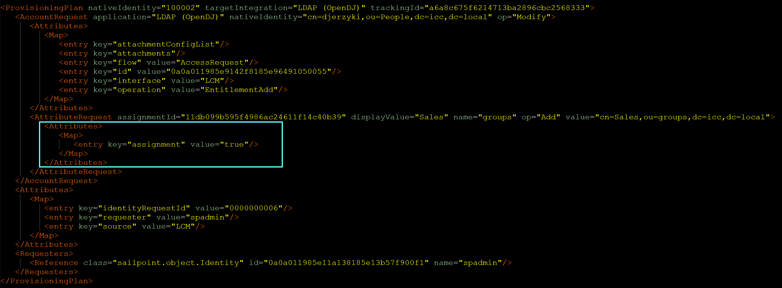
Appendix A: Provisioning Plan that will create an AttributeAssignment

Slide 9
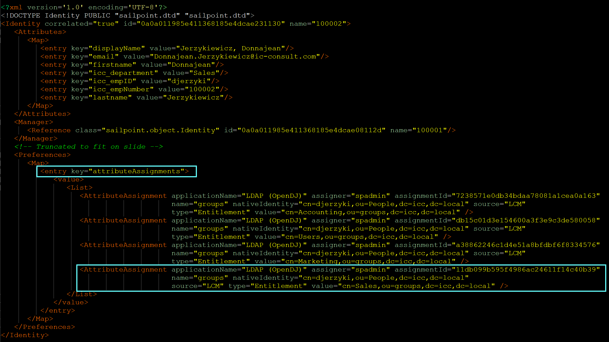
Appendix A: AttributeAssignment created when plan is executed

Slide 10
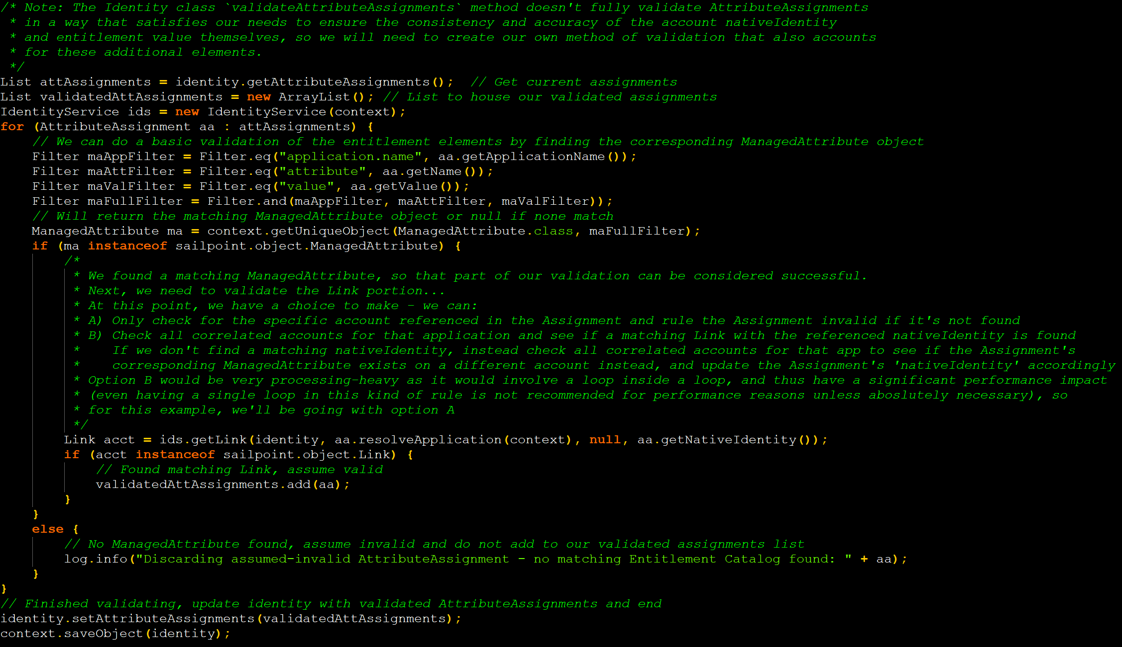
Appendix B: Pseudo-code for a PreRefresh Rule for Option 1

Slide 11
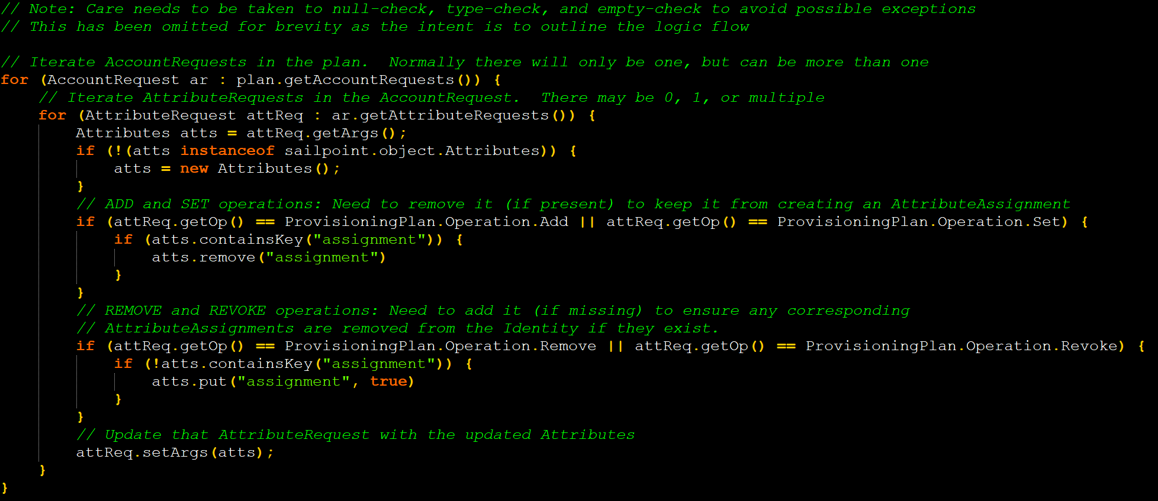
Appendix C: Pseudo-code for a BeforeProvisioning Rule for Option 2

Slide 12
Appendix C: Pseudo-code for a BeforeProvisioning Rule for Option 2

