Slide 1
Solving the Uniqueness Challenge
Julian Agbeke Engineer iC-Consult

Slide 2
Agenda
IDNRuleUtil
Rule Development Process
Demo
Purpose
How can it be utilized
Commonly used methods
Rule creation to leverage IDNRuleUtil in a test environment
Unit testing Rules to an acceptable degree of coverage
See all components in action

Slide 3
IDNRuleUtil (What is it?)
Primarily used to generate unique account attributes (using Identity attributes) for account creation usage Set of methods that can be used to search account attributes for uniqueness Can be utilized for a single, or extended across multiple sources
IDNRul Util Rule AD account: User: Tom Ford
Iter 1: tford (collision from AD)
Iter2: toford (collision from Azure)
Iter3: tomford (no collision in either source)
AD
Azure AD
Account Samaccountnames: tford
Account Samaccountnames: toford
tomford

Slide 4
IDNRuleUtil (Methods of Interest)
Get Identity Object Detail Methods
/**
* Get the display name of the identity
* @return The displayName
*/
public String getDisplayName()
/**
* Get the internal unique identifier.
* @return The id
*/
public String getId()
/**
* Get the first name of the Identity.
* @return The FirstName
*/
public String getFirstName()
/**
* Get the last name of the Identity.
* @return The LastName
*/
public String getLastName()
/**
Get the specified value of the Identity using the
technical name.
@param attributeName The technical name of the attribute to retrieve
* @return The LastName
*/
public String getAttribute(String attributeName)

Slide 5
IDNRuleUtil (Methods of Interest)
Uniqueness Checking Methods
/**
* A method that can be used to call LDAP type connectors to look for
* unique values. The connector is called with a specific search filter
* based on the attributeName and value that is passed into this method.
* If there is a value returned the values is considered to be non-unique.
*
* @param identityNameOrId The name or ID of the identity we are using
* @param applicationNameOrId The name or ID of the source we are targeting
* @param attributeName The name of the attribute we want to validate
* @param attributeValue The value of the attribute we want to validate
*
* @return true if the value is unique AND false otherwise. If the application or identity can't be found an
* IllegalStateException will be thrown.
*
*/
public boolean isUniqueLDAPValue(String identityNameOrId, String applicationNameOrId, String attributeName, String attributeValue)
}
/**
* Count the accounts that match the searchable attribute and value.
*
* @param sourceIds The list of Application ids that represent the sources of the data.
* @param attributeName The name of the searchable account attribute. The name parameter is required.
* @param operation The operation to use when matching, it'll either be Equals or StartsWith.
* @param values The list of values of that searchable attribute to match. The values parameter is required.
*
* @return The number of accounts that match the parameters provided.
* @throws IllegalStateException wrapping underlying errors
*/
int attrSearchCountAccounts(List<String> sourceIds, String attributeName, String operation, List<String> values)

Slide 6
IDNRuleUtil (IDN Context Fields)
Input
Argument | Type | Purpose
log | org.apache.log4j.Logger | A logger to log statements. Note: This executes in the cloud and logging is currently not exposed to anyone other than SailPoint.
idn | sailpoint.server.IdnRuleUtil | Provides a read-only starting point for using the SailPoint API. From this passed reference, the rule can interrogate the IdentityNow data model including identities or account information via helper methods as described here.
identity | sailpoint.object.Identity | A read-only reference to identity object that represents the identity being provisioned.
application | sailpoint.object.Application | A read-only reference to application object that represents the source to which provisioning is being done.
field | sailpoint.object.Field | A field object which is used to get information about the attribute being generated.

Slide 7
IDNRuleUtil (How to Utilize it)
Configure attributes within IdentityNow System to allow for searching
Create Rule to generate attribute and query Existing Attributes for conflicts
1.Get External ID’s for desired sources
GET {{api-url}}/cc/api/source/get/{{source-id}}
2. Create searchable attribures
POST {{api-url}}/beta/accounts/search-attribute-config/
{
"name": "promotedEmailAddress",
"displayName": "Promoted Email Address",
"applicationAttributes":
{
"4028112837fe14c70177fe1955e9032c": "mail",
"4028812877fa18c72177fs195baa0341": "emailAddress"
}
}
3.Veriify searchable attributes were created.
GET {{api-url}}/beta/accounts/search-attribute-config/
Returns an id to be used in the creation of searchable attributes
<?xml version='1.0' encoding='UTF-8'?>
<!DOCTYPE Rule PUBLIC "sailpoint.dtd" "sailpoint.dtd">
<Rule name="Example Rule" type="AttributeGenerator">
<Description>Describe your rule here.</Description>
<Source><![CDATA[
// Add your logic here.
…
…
…
List EMAIL_ATTRIBUTE_SOURCE_ID_LIST = new ArrayList(Arrays.asList(new String[] {
"d4813ba1cdf340a2af9a3048ebb750cd", "fec8c4f6210f4b1687d8e5b18c332c37"}));
…
… generate your proposed email
…
List searchValues = new ArrayList(Arrays.asList(new String[] {
generatedEmail}));
Return idn.attrSearchCountAccounts(EMAIL_ATTRIBUTE_SOURCE_ID_LIST , promotedEmailAddress, “Equals”, List<String> searchValues)
…
…
…
//String firstName = StringUtils.trimToNull(identity.getFirstname());
//String lastName = StringUtils.trimToNull(identity.getLastname());
String middleName = StringUtils.trimToNull(identity.getAttribute("middleName"));
…
… call function to process email with the identity attributes retrieved
…
]]></Source>
</Rule>
Name of searchable attribute to be referenced in rule
External ID of source:attribute of interest as named in source schema
Returns all configured attributes

Slide 8
Questions?

Slide 9
Rule Development Process
Objectives
Create Rule
Suggested Standard work for developing Rules using test driven development
Create Junit Tests to represent requirements in java ide
Create Java class equivalent of Beanshell script to run against unit tests
Ensure all tests pass and test have a high code coverage
Validate syntax used in Java Equivalent Class using Apache Jmeter
Transpose Java class to Beanshell script in XML
Run script against Sailpoint Validator jar
Submit Rule for review and deployment by expert services

Slide 10
Rule Development Process
Suggested Standard Work for Developing
Pros:
JUnit test and results serve as measurable, repeatable evidence to support rule has met specifications
Use of IDE can determine code coverage from unit tests
Able to pinpoint (with some level of accuracy) syntax issues between beanshell and various versions of java
Cons
Transposition of code from Java to XML introduces room for errors on the final iteration
Unable to test IDN specific methods

Slide 11
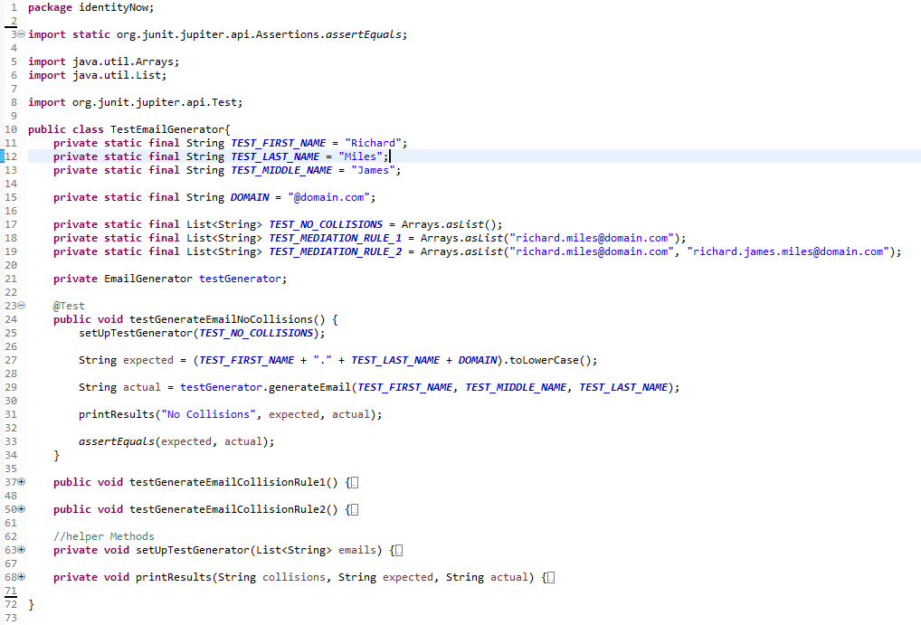
Rule Development Process
Create JUnit Tests to Represent Requirements in Java IDE

Slide 12
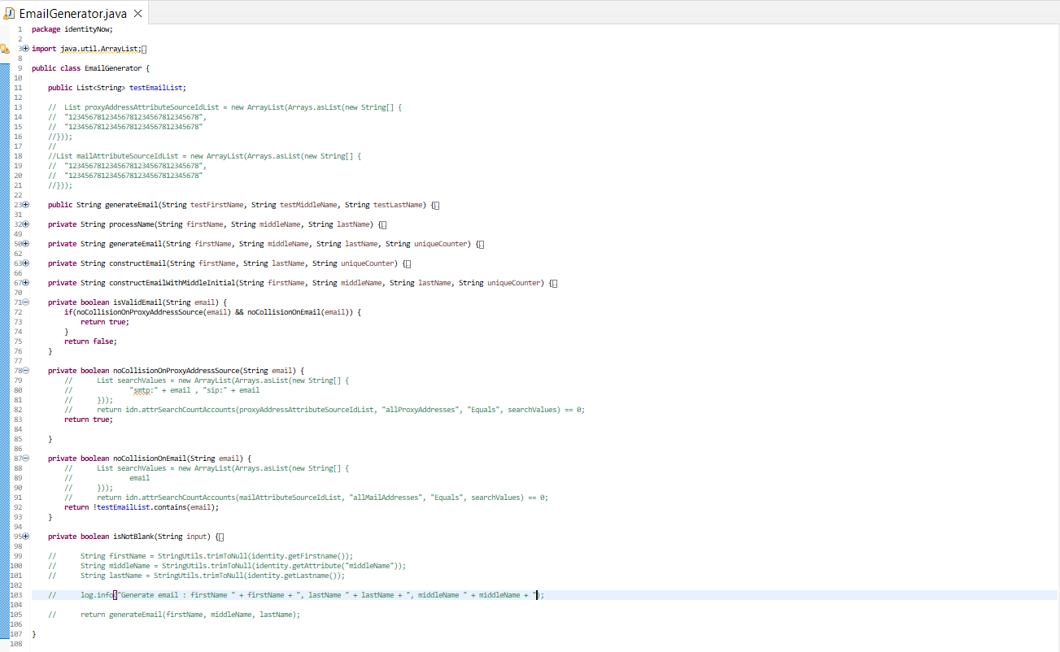
Rule Development Process
Create Java Class Equivalent of Beanshell Script to Run Against Unit Tests

Slide 13
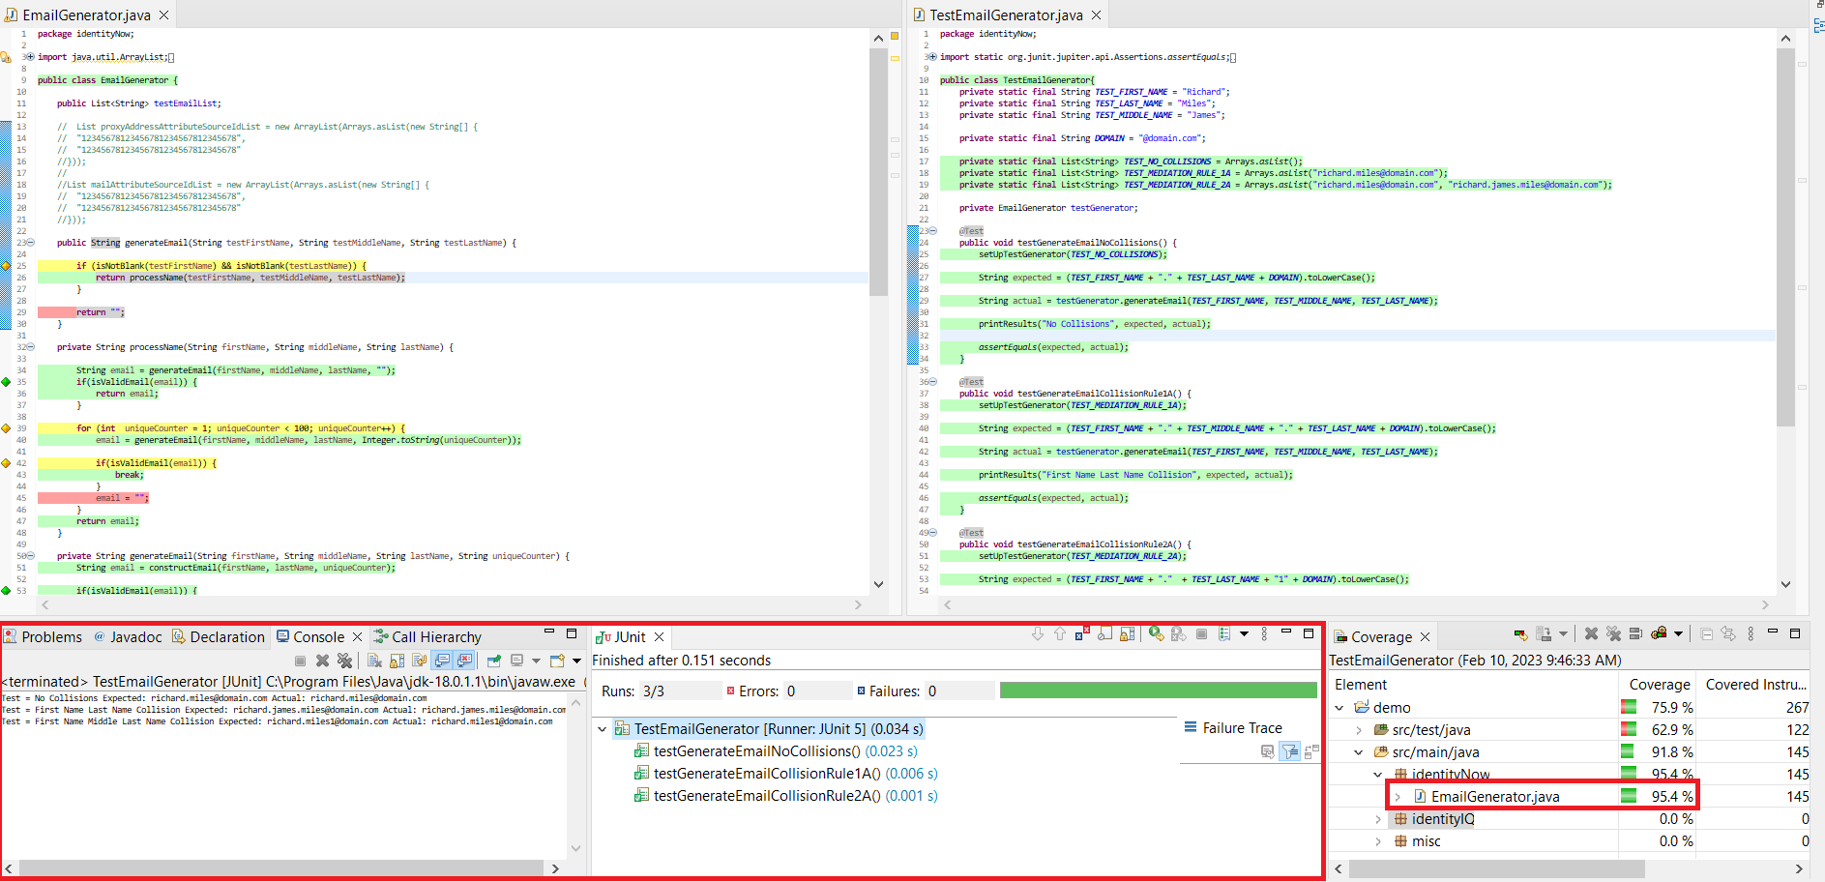
Rule Development Process
Ensure all Tests Pass and Have a High Code Coverage

Slide 14
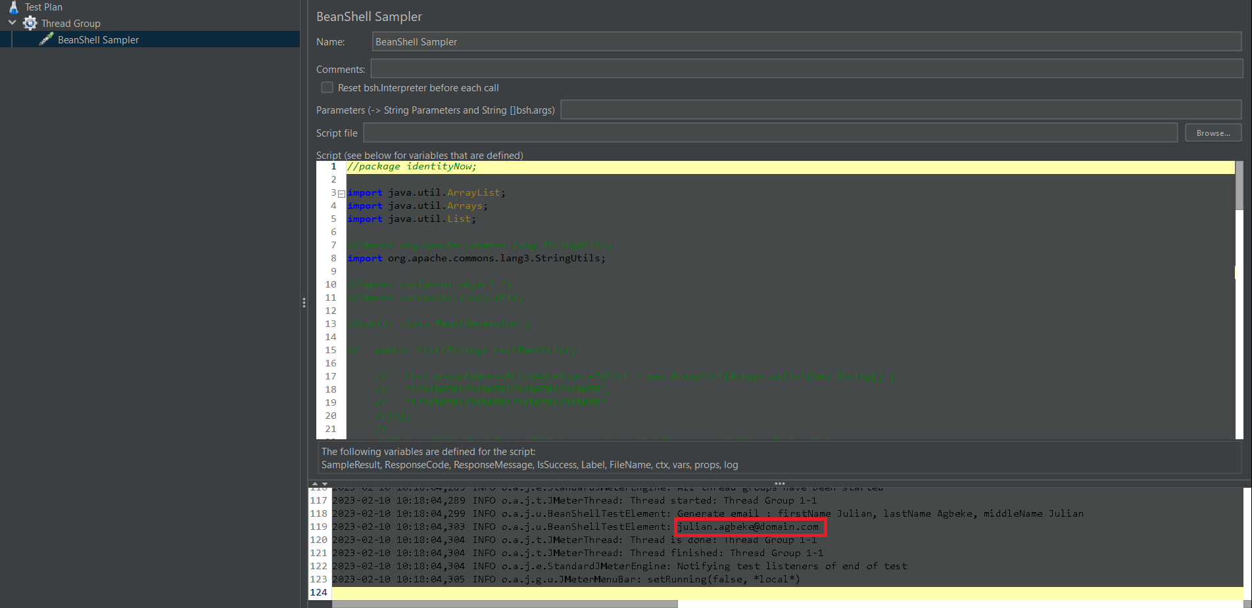
Rule Development Process
Validate Java Equivalent Class Syntax

Slide 15
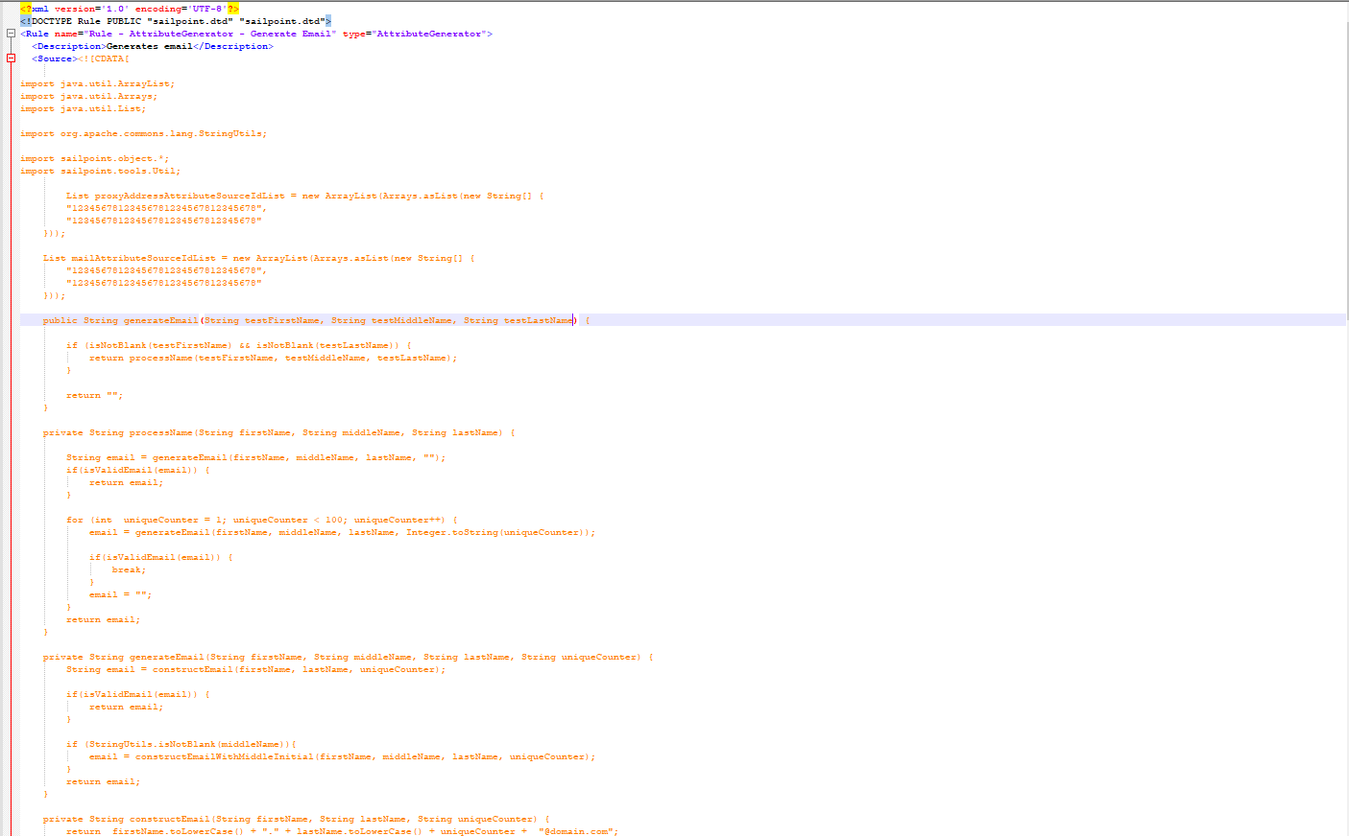
Rule Development Process
Transpose Java Class to Beanshell Script in XML

Slide 16
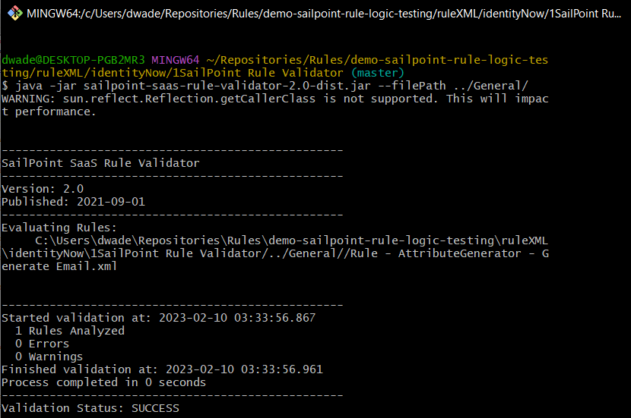
Rule Development Process
Run Script Against Sailpoint Validator JAR

Slide 17
Questions?

Slide 18
Demo
Email Generation Rule

Slide 19
Sources
Using IDNRuleUtil as a Wrapper for Common Rule Operations
How to Search Non-Indexed Account Attributes in IDN Rules for Uniqueness
IdentityNow Rule Guide - Account Profile Attribute Generator
IdentityNow Rule Validator

Slide 20
Thank you!

