Slide 1

File Access Manager: Activities REST API
Speaker: Hanan Levy;
title: Product Line Manager, Data Security
company: SailPoint;

Slide 2
Activities REST API
Generic Connectivity
Secured Authentication
Extending FAM Generic connectivity layer to include Activity Monitoring and dependent advanced governance
Full OAuth 2.0 authentication, dedicated token scopes for least-privileged access, and secure TLS (HTTPS) support
Introducing a new Activity Data ingest API enabling Activity Monitoring and File Audit processing.
Extending the File Access Manager Platform support and governance controls to additional endpoints,
and non-native connectivity
Govern Data at Scale
Full Governance Support
The Activities REST API offers support for bulk data ingestion for high volumes of data –
for highly active environments
Support activities data enrichment of actors’ identity information, access sensitivity and data classification.
Access Policy Enforcement, Alerts and responses

Slide 3


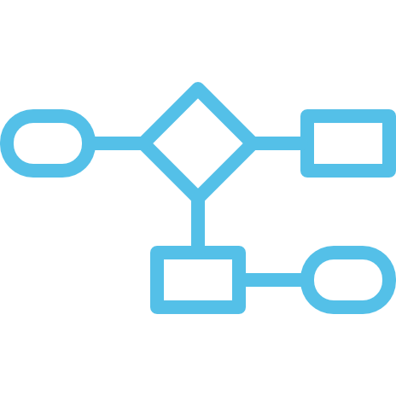





Unlock Advanced Governance
Monitor How
Access is Used
Real-Time
Threat Detection
Alerts, Automated Responses & Forensics
Detect & Manage Stale Data
Eliminate Excessive & Unused Access
Enforce Dynamic Data Access Policies
Intercept ransomware
& other brute-force attacks
Reducing data exposure risk & breach attack surface
Establish
Data Ownership
Notes:
File Access Manager is designed to help organizations
attain control and governance over their unstructured data – be it on the premises or in the cloud
And assists you in
Locating your Sensitive data. Understanding where your data is stored, and then identifying which data is sensitive and needs extra protection.
Whether its PII information, IP or data subject to regulation such as GDPR, HIPAA, SOX, PCI, or the California’s Consumer Privacy Act,
through a comprehensive array of policy rules that include everything from free text search, wildcard matching and regular expression patterns, on every aspect of the data.
Understand who has access to these sensitive resources and where their access comes from,
By analyzing the permissions and access rights granted across all applications and storage solutions,
on prem and in the cloud
whether they are directly assigned, or propagated through complex nested group hierarchies
It also monitors every activity on the data to see what people are doing – who actually IS accessing which resources, especially the sensitive ones,
by monitoring all activities taking place on the managed end – systems,
whether it’s reading, writing, or moving data
sharing or changing permissions,
and more.
File Access Manager can put controls in place to protect your highly regulated data.
Which can take multiple forms including:
Certifications to manage who has access to specific resources,
Highlighting risk factors in your current access landscape,
Providing remediation steps and improving access models,
and addressing over-exposed resources or over-permissive access
By Detecting suspicious, unwarranted or unauthorize access, through activity monitoring
trigger notifications and alert in real-time, leverage SIEM integrations, and remediation actions
– such as shutting down all access and break-glass workflows
File Access Manager Helps you make all this more manageable – offloading the burden from your IT and security team,
offering a unique approach
Democratizing governance and ownership,
by Delegating the responsibility over data – to the people who know it the most
through our patented Data Ownership election and assignment processes
It also Saves you money and improve your security posture – by helping you dispose of data you’re not using,
based on real usage statistics,
helping you reduce storage costs and management overhead,
prepare for cloud migration
and reduce attack surface
And of course as since all this is done, tracked and monitored through the platform – you can rest assured your compliance and audit requirements are met,
with maximum ease.

Slide 4
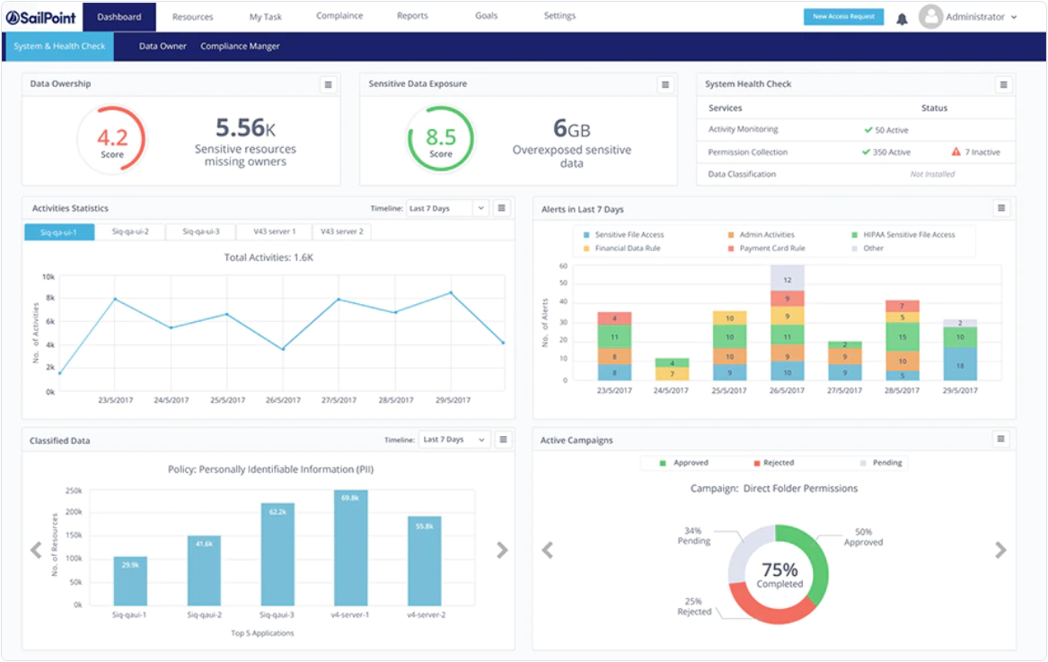
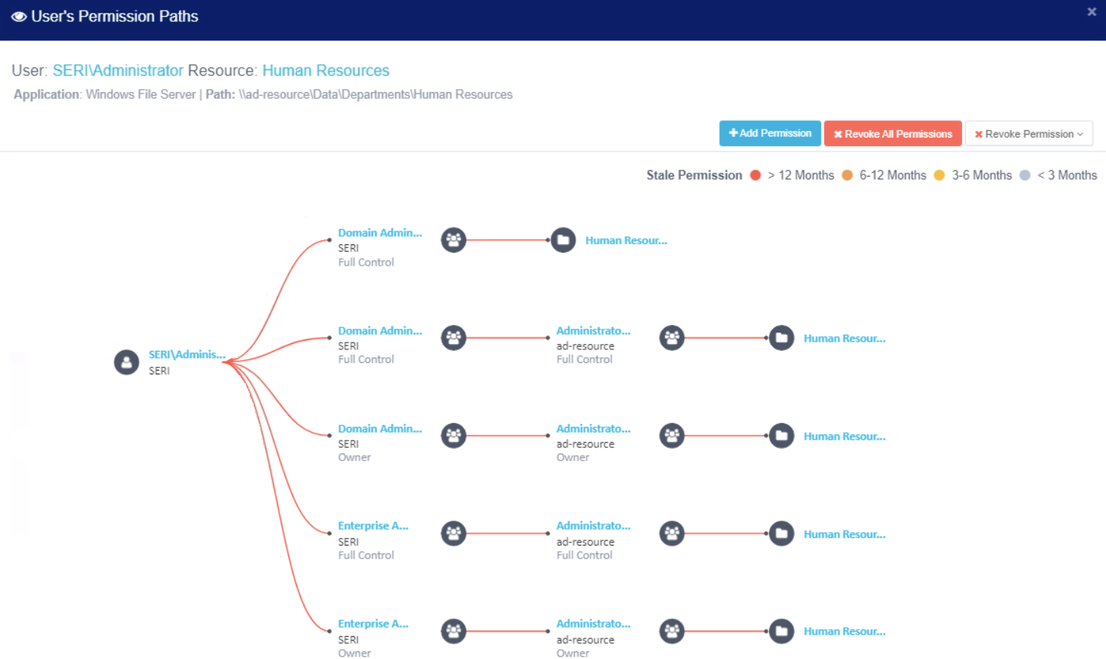
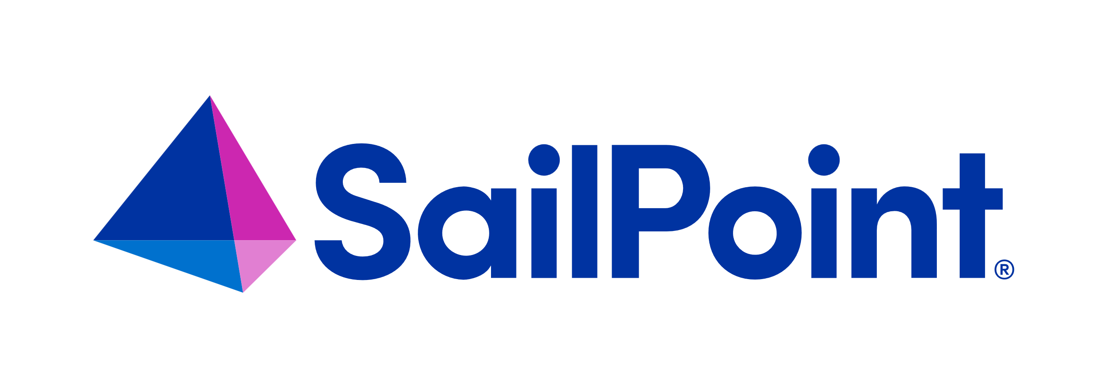
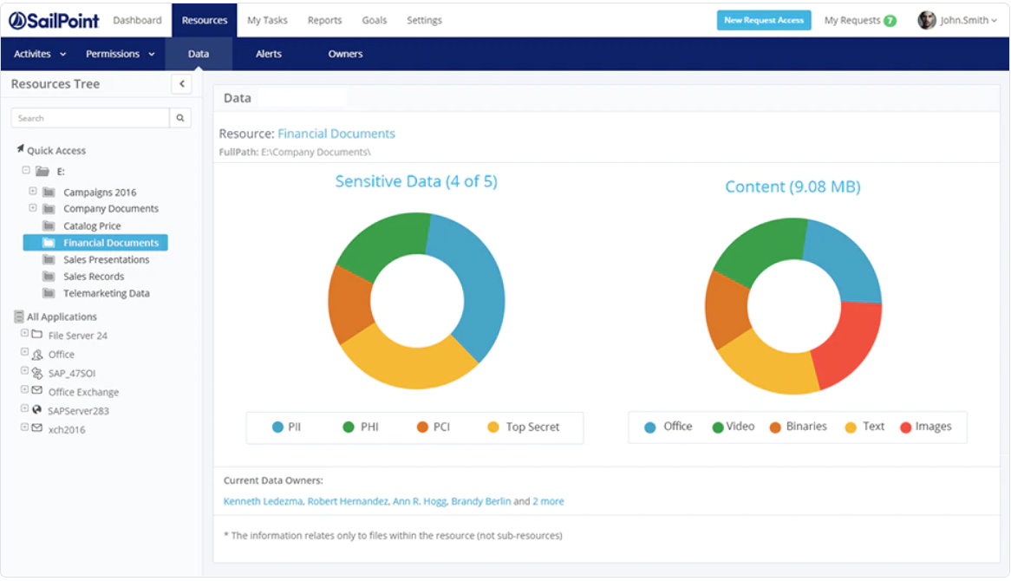
Enable Advanced Monitoring
Notes:
File Access Manager lets you govern access with ease –
Through analytic dashboards,
That provide real-time actionable insights,
And an intuitive user experience

Slide 5
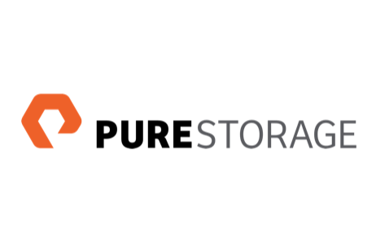


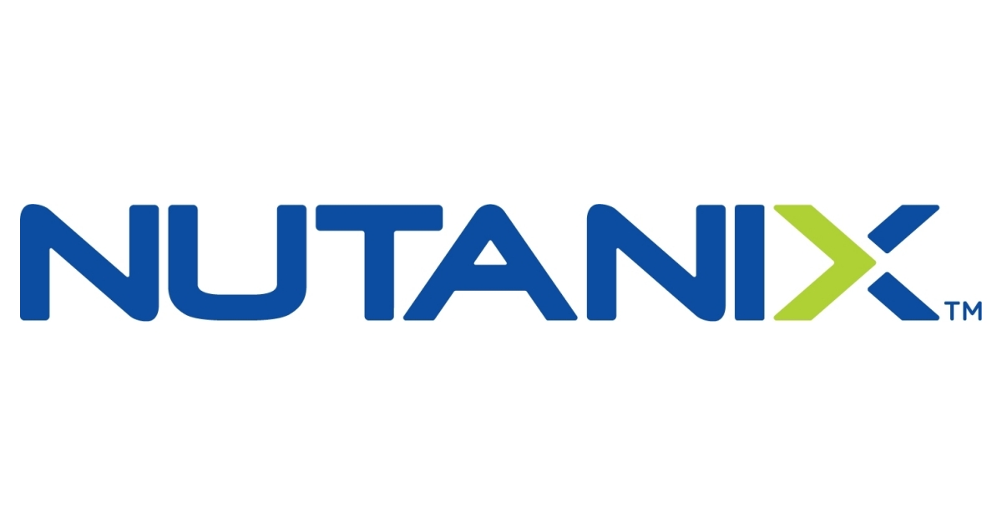




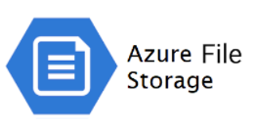
Supported Endpoint
Generic & Non-Native Connectivity
NFS/CIFS Storage Solutions
Any storage solution exposing CIFS/NFS protocols
and many more
Linux
AWS S3
Azure Files
Easily Extendable & Customizable

Slide 6
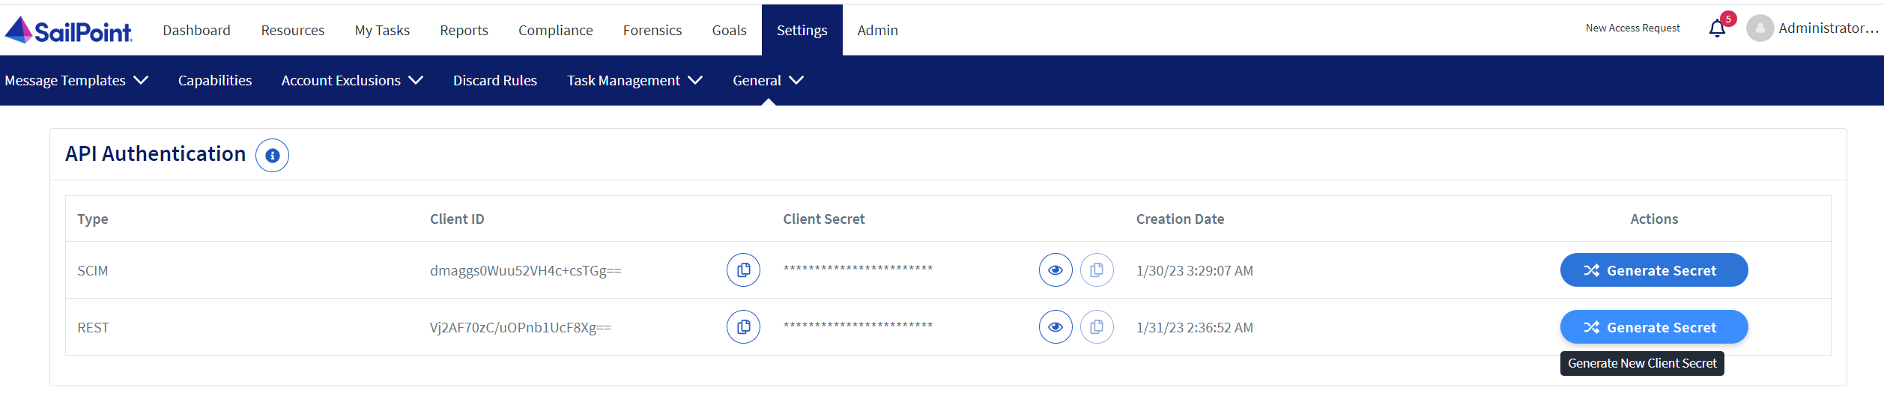
Token Generation & Refresh
API Authentication Screen
Settings > General > API Authentication

Slide 7
Token Generation & Refresh
GET /Token Endpoint
Response
Get Token
"grant_type=client_credentials&scope=api&client_id=[CLIENT_ID_URL_ENCODED]&client_secret=[CLIENT_SECRET_URL_ENCODED] “
Refresh Token
"grant_type=refresh_token&scope=api&client_id=[CLIENT_ID_URL_ENCODED]&client_secret=[CLIENT_SECRET_URL_ENCODED]&refresh_token=[CLIENT_REFRESH_TOKEN_URL_ENCODED]"
{"expires_in":86400.0,
"scope":"api",
"access_token":"eyJ0eXAiOiJKV1QiLCJh-bGciOiJSUzI1NiIsImt-pZCI6IjZjNTZlMDJlLWJmNTMtNDE1Mi1hZDZmLTI3ZDh-hYWVkZGIzNSJ9.eyJh-dWQiOls-ibHl1K3ZPU3N3Qk1xZkxXbzBh-bU9nQT09Il0sIm-lzcyI6Im-h0dHA6Ly9s-b2Nh-bGhvc3Q6ODAxMSIsInNjb3BlIjp-bImFwaSJdLCJpYXQiOjE2NzQ2NDA3MjUuMCwiZXh-wIjoxNjc0NzI3MTI1LjB9.Qy3zG8Fj4i6aP4H4r5gLLI9DTPaXzFRrhsv3dWoAZlPvSfDT9oJzCMTPJQnz1OR4-CIN2lu8j482fArDwJ9WlkwuGi8aciUzvMrO6-wl90kDvKfiV60GlZFoEVjXebKnkyi1SRF_5l8IJ7VsHFGl91wzhPnVxLZfM8zy82tfWFyu_nXaNq1MGQY3e54KUeVo29rXoARvKGBxr-bvSoLmiBthUHU0INz-sddb7aaGy- API Authentication Screen SailPoint File Access Manager Rest API iv f9uPHLn-inhGouhU9XPB7DVg0zMF6VF67xDMdzV9WA8i-w5Duz7c8oSln8pHaj8mEF4AXLBdQtCwLVeOLvaeuHeoThayhZgaOPEOz5n952G8a9Tfg",
"refresh_token":"40a5d02f-7570-4659-9e59-97dfbb726ece",
"token_type":"Bearer"}

Slide 8
Token Generation & Refresh
POST /Activities Endpoint
Request Body
Header
{"Authorization":"Bearer eyJ0eXAiOiJKV1QiLCJh … “}
[
{"applicationName":"APPLICATION NAME1",
"timestamp":"2022-12-18T10:40:58.9839062Z",
"userName":"administrator",
"objectName":"file_name.txt",
"action":"Read",
"resource":"\\\\host\\share1\\temp\\foler Name",
"userDomain":"acme",
"extraProperties":
{
"ipAddress":"1.2.3.4",
"objectNewName":"",
"newResource":"",
"fileExtension":"txt",
"objectType":"File",
"oldName":""
"oldResource":"
}
}
{"applicationName":" APPLICATION NAME2",
"timestamp":"2022-12-18T13:40:58.9839062Z",
"userName":"john_doe@acme.com",
"objectName":"personal_details.xlsx",
"action":"Write",
"resource":"\\\\host\\e$\\data",
"userDomain":"",
"extraProperties":
{
"fileExtension":"txt",
"objectType":"File"
}
}
]
Mandatory Fields
applicationName
timestamp (ISO 8601)
userName
objectName
action
resource
Notes:
UserName
ipAddress
userDomain
ObjectName
Action
objectNewName
Resource
newResource
objectType
oldName
oldResource
fileExtension
ClassificationCategory
AlertRuleNames
ApplicationType
LogicalPaths
LogicalBamIds

Slide 9
Token Generation & Refresh
POST /Activities Endpoint
Validations
Response
applicationName
resource
{
"successfulActivities":1,
"activityResponses":[
{
"activity":{
"applicationName":"APPLICATION NAME2",
"timestamp":"2022-12-18T13:40:58.9839062Z",
"userName":"john_doe@acme.com",
“objectName":"personal_details.xlsx",
"action":"Write",
"resource":"\\host\e$\data",
"userDomain":"",
"extraProperties":{
"fileExtension":"txt",
"objectType":"File"
}
},
"errorMsgs":[
"Application 'APPLICATION NAME2' not found or isn't supported. Dis- carding activity."
]
}
]
}
Supported Fields
UserName – Activity actor user name
ipAddress – IP action generated from
userDomain - Activity actor user name’s domain
ObjectName – File / folder / assets acted on
Action – The type of action performed
objectNewName – Used in File / Folder / Asset Rename operations
Resource – The name of the container Data Asset / Folder acted in
newResource – Used in File / Folder / Assets Move operations
objectType – File, Folder or other Assrts
oldName - Used in File / Folder / Asset Rename operations
oldResource - Used in File / Folder / Assets Move operations

Slide 10


Thank you!

