Slide 1
Event Triggers to Systems Behind the Firewall
Speaker: Menno Pieters; title: Principal Solution Architect; company: SailPoint;

Slide 2
Agenda
Introduction
Usage
API
Demo

Slide 3
Introduction

Slide 4
Business Problem
✓
IdentityNow Triggers are cloud to cloud

Slide 5
Business Problem
?
IdentityNow Triggers are mostly “fire and forget”, no retry.

Slide 6
Business Problem
Firewall
Notifying on-prem systems requires firewalls to be opened

Slide 7
Solution
Trigger
Poll
Queue
Trigger Cloud Queue

Slide 8
Solution
Start
Timer
Receive Trigger
Poll Trigger
Retrieve Trigger
Store Trigger
Answer

Slide 9
Usage

Slide 10
Deployment
Create database (MySQL)
Extract war file
Edit WEB-INF/classes/queue.properties
db.pool.url=jdbc:mysql://localhost/etscloudqueue?useSSL=false
db.pool.user=etscloudqueue
db.pool.password=********
db.pool.driver=com.mysql.jdbc.Driver
db.queue.maxage=3600
admin.user=spadmin
admin.pass={SSHA256}********

Slide 11
API

Slide 12
Terminology
{{url}}: base url for the service, e.g. https://ets.example.com/queue
{{user_id}}: user identifier (GUID)
{{queue}}: queue identifier (GUID)

Slide 13
Ping
GET {{url}}/rest/ping
Returns:
Pong

Slide 14
Admin Authentication
User / Password defined in queue.properties
admin.user=spadmin
admin.pass={SSHA256}ZE…Ho=
BASIC authentication
Use a long password!
Generate hash:
Command line (see README)
API: GET {{url}}/rest/admin/hash/{{password}}
GET {{url}}/rest/admin/hash/V3ryS3cr3tP@ssw0rd
{SSHA256}bVNpM0tGcWU=$ovUcqCqc8+Y+EFBAm/Pb5ZALaU97KlgBa4Km+H0dRis=

Slide 15
Admin Features
List/create/delete queues
List/create/delete users
List/create/delete user tokens
Authorized/de-authorize users to queues (read and/or write)

Slide 16
IdentityNow Client Features
Post trigger to queue
POST {{url}}/rest/event/trigger/{{queue}}
{
"fileName": "Search Export.2020-07-22 12'34 GMT",
"__hasMore": true,
"ownerName": "John Doe",
"query": "attributes.cloudLifecycleState:inactive AND @accounts(disabled:false AND source.name:LDAP)",
"searchName": "Inactive Identities with Active Accounts",
…
}

Slide 17
Receiving Client Features
Peek: check for new message without removing it from the queue
GET {{url}}/rest/event/peek/{{queue}}
Poll: get one message and remove it from the queue
GET {{url}}/rest/event/poll/{{queue}}
Both will return one message, exactly as it was queued.
First in, first out.

Slide 18
Demo
Postman API

Slide 19
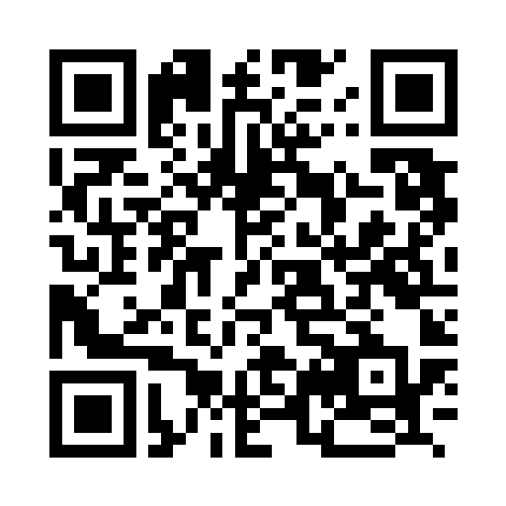
More Information
Git Repo: https://github.com/menno-pieters-sp/ets-cloud-queue

Slide 20
Thank you!

