Slide 1
Plugin Development Frontend Solution with JavaScript MutationObserver
Speaker: Yu-Chih Chung (Mike); title: Senior Solution Consultant, CISSP, SailPoint Certified IdentityIQ Architect; company: KOGIT GmbH;
Notes:
Hello Developers,
Welcome to the Plugin Development Frontend solution with Javascript MutationObserver session.
My name is Mike Chung. I am a Senior Solution Consultant at KOGIT, and also a certified SailPoint IdentityIQ Security Architect.
I am originally from Taiwan. At the moment I live in Germany.
Currently, one of my main responsibilities within KOGIT is in charge of our plugin developments and maintenances.

Slide 2
Agenda
Introduction
IDE Setup
JavaScript MutationObserver and Hashchange (KOGIT Access Request Extension Plugin)
Demo
References
FAQ (on developer community)
Notes:
Here is the Agenda of today‘s session. We will start with a short introduction.
Then we will also align on the IDE used in this practice.
In this session, we use part of the code from KOGIT Access Request Plugin to demonstrate how Javascript MutationObserver benefits the IIQ Plugin Development.
After all, there will be a demo session, and references of the materials.
There will be no FAQ session, instead, please leave your questions in the chat or on the developer community post.
And here we Start!

Slide 3
Who‘s KOGIT
A Europe-wide recognized and leading consulting firm, who aim to develop secure and innovative solutions for customized Identity and Access Management (IAM).
SailPoint 2022 Delivery Admiral.
Notes:
First of all, as an employee of KOGIT, allow me to briefly introduce my company.
We are one of the leading consultency firm in Germany, especially in IAM area.
We are also a solid partner with SailPoint in Europe.

Slide 4
KOGIT Consulting and Services
Analysis
Analysis of existing structures and processes (gap analysis / IAM assessment)
Consulting
Consulting in the area of technology, strategy and processes
Conception & Design
Product evaluation, feasibility studies, concepts, prototype development
Implementation
Implementation, customer-specific enhancements, roll-out, operation
Support
2nd & 3rd Level Solution Support Service
Notes:
Our company provides Consultency services including Analysis, Implementations and Technical Support.

Slide 5
KOGIT Services
Identity Management
Structured and transparent management of identities of all types
Access Management
Which identity gets how, when & with which rights access to which IT systems & data
Compliance
Regulatory compliance through credential monitoring, analysis & periodic recertification.
Privileged Access Management
Protect privileged user accounts & access rights from data breaches through efficient control
Security Information & Event Management
Collection & analysis of messages and log files, real-time detection of potential threats
Advanced Analytics
Identify risks of unauthorized data access/theft at an early stage & initiate defensive measures
Notes:
Additionally, we also provide PAM solutions (such as BeyondTrust and CyberARk) and Role Analysis solutions to our customers.

Slide 6
KOGIT Plugin Library
KOGIT History Plugin
KOGIT Role Analytics Plugin
KOGIT SIEM Plugin
KOGIT SoD-Matrix Plugin
KOGIT Monitoring Plugin
KOGIT Assignment Calendar Plugin
KOGIT Access Request Extension Plugin
KOGIT Org Chart Plugin
Notes:
We also published some interesting plugin solutions on the market.
Here are the list of KOGIT IIQ Plugin library, most of them are certified and available on Compass to be inquiried.

Slide 7
IDE Setup

Slide 8
Suggested Knowledge
Plugin Developer Guide – Overview
SailPoint University: IdentityIQ Advanced Implementation: Plugins v8.3 - ELEARNING
Notes:
Before we start I would still strongly suggest developers to have some extended knowledge in IIQ Plugin Development.
Here are the list of resources as a starting point for your journey.

Slide 9
Environment Setup
Eclipse + IIQDA
Visual Studio Code
IIQ 8.3 instance
Notes:
Environment Setup
First, here I mainly use Eclipse+IIQDA mainly for Plugin Project creation.
Second, I use VS Code mainly for the Javascript developement.
An IIQ instance is required for testing. I will use IIQ 8.3 as the demo server later in the presentation.

Slide 10
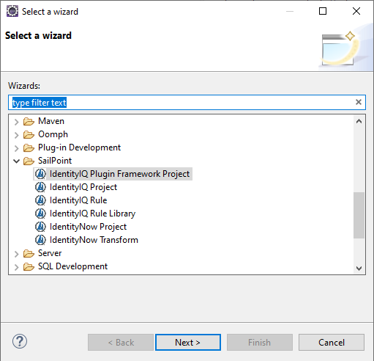
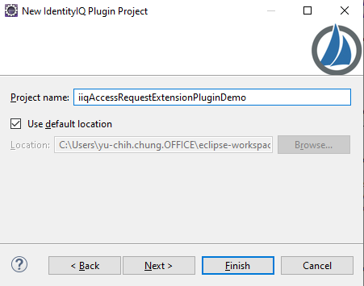
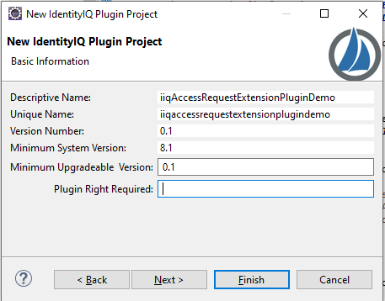
Initiate Plugin Framework Project
File > Other > IdentityIQ Plugin Framework Project
Delete files under import/ and db/
Notes:
First of all, let‘s create a Plugin Framework Ant Build project.
As a shortcut to initiate an IIQ Plugin project, we will use the Wizard from IIQDA on Eclipse.

Slide 11
Create JavaScript Files
Create ui/js/ folder under web/ folder
Download hashchange library: https://github.com/cowboy/jquery-hashchange , and place under web/ui/js/ folder
Create web/ui/js/accessRequestManageAccessInject.js
Notes:
1. Create ui/js/ folder under web/ folder
2. Download hashchange library: https://github.com/cowboy/jquery-hashchange , and place under web/ui/js/ folder
3. Create web/ui/js/accessRequestManageAccessInject.js

Slide 12
JavaScript MutationObserver and Hashchange
KOGIT Access Request Extension Plugin

Slide 13
Why MutationObserver?
Starting with IIQ 8.x some of pages (e.g. LCM Manage User Access) is using AngularJS as single page application. Which the page is dynamically rendering instead of static HTML page.
And this makes hard to use JavaScript snippet to inject custom DOM object into those pages.
Utilize MutationObserver and Hashchange Event to customize Manage User Access frontend.
Credit: Christian Cairney (post)
Notes:
Why MutationObserver?
Starting with IIQ 8 some of pages (such as LCM Manage User Access) is using AngularJS as single page application. A Single Page Application is a web application that load a single HTML page, and during each triggered event only a part of the page gets updated instead of the entire page. And this makes it hard to use JavaScript snippet to inject custom DOM object into those pages. As the corresponding component is dynamically loaded.
Several months before while I asked this question on the developer community Christian Cairney hinted me that MutationObserver can be used to achieve overcome the bottleneck.
In this session, we will MutationObserver and Hashchange event to customize the Manage user Access flow.

Slide 14
MutationObserver & Hashchange Event
MutationObserver is a Web API provided by modern browsers for detecting changes in the DOM. With this API one can listen to newly added or removed nodes, attribute changes or changes in the text content of text nodes.
The Hashchange event is fired when the fragment identifier of the URL has changed (the part of the URL beginning with and following the # symbol)
Notes:
MutationObserver is a Web API provided by modern browsers to detect changes in the DOM.
The Hashchange event triggered when the fragment identifier of the URL has changed.

Slide 15
KOGIT Access Request Extension Plugin
Search Identities which own a given Account
Account Selection Filter
Access Request for Multi-Account, Shared/Technical accounts
Access Request for Multi-Account, Shared/Technical accounts, big Identities
The main goal of this plugin is to provide a better UI/UX experience for the end-user throughout the Manage User Access process. It provides the possibility to search for an identity with application account, enforces mandatory Sunrise/Sunset date for requested entitlement or role and performs validation for the Start/End date.
Link: Compass page
Validation on the Request Submission
Comment Allow List for Entitlement/Role
Required End Date for VPN access request; Restriction on USB Access scheduled assignment date range
Normalize Requester Comments
Notes:
In this practice we demonstrate partial code used by KOGIT Access Request Extension Plugin. The plugin has provided several features including Mandatory Sunrise/Sunset and validation on the request submission.
But today we mainly focus on the Search Filter within Account Selection Modal.

Slide 16
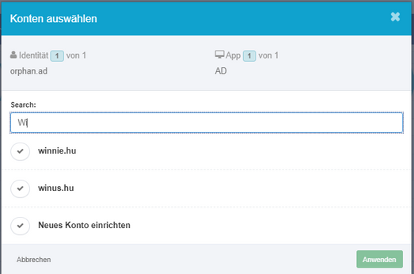
Search Filter in Access Request Select Accounts (Without Plugin)
Compass post: link
Adjust the SailPointClassicBundle.js and SailPointBundle.js:
Notes:
The use case on the Account Selection Modal is that there is no scroll bar nor filter. This makes it difficult while select account on an identity which has a lot of correlated accounts.
On Compass, I have also posted a solution which we can do some black customization on the SailPointBundle libraries to have a search filter available on the account selection modal.
However, such black customization may not be a good idea in terms of maintenance or during upgrade.

Slide 17
Find the HTML object
Right click on the Account Selection Modal and select Inspect.
Notes:
Therefore, we have the idea to build a plugin using Javascript snippet to customize the GUI of Manage User Access flow.
However, there is no official document per my knowledge, describe the entire frontend. So the easiest approach here is to using the browser developer tool to inspect which component we want to customize.

Slide 18
Div: accountSelectionDialog
Here we notice the id of Modal div id, which is “accountSelectionDialog”.
Same approach can be used in every frontend pages to get the id of the html object. Which can be used later to modify the DOM object by JQuery.
Notes:
In this case, we focus on the directive with id accountSelectionDialog.

Slide 19
Define MutationObserver
Then we define the MutationObserver function, the mutations_list contains the object dynamically added into DOM.
We iterate every mutation object and search for the element with id “accountSelectionDialog”.
Notes:
Then we define the MutationObserver function, to monitor if the accountSelectionDialog directive has been added into the DOM.

Slide 20
JQuery: Add Search Input Filter
Add a search filter input box.
Trigger filterAccountSelections function on each key up event.
Notes:
Once the accountSelectionDialog directive is detected, we can then use Jquery to insert our custom search input.
The search input field has a key up event, it triggers the filterAccountSelections function.

Slide 21
Function: filterAccountSelections
This function loop through all ng-repeat object and compare if the account name contains the input value. If not then hide the object.
.style.display == “none” // hide
Notes:
This filterAccountSelections function loop through all ng-repeat object (which are the selectable accounts) and compare if the account name contains the input value. If not then hide the object.

Slide 22
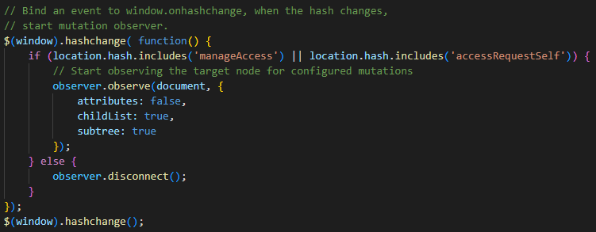
Windows Hashchange Event
The hashchange event is fired when the fragment identifier of the URL has changed (the part of the URL beginning with and following the # symbol)
Once hashchange detected the page is manageAccess, then we start the MutationObserver
Notes:
The hashchange event is used to only start MutationObserver if we are in the manageAccess page.
As we dont want to cost additional browser compuation power on other pages.

Slide 23
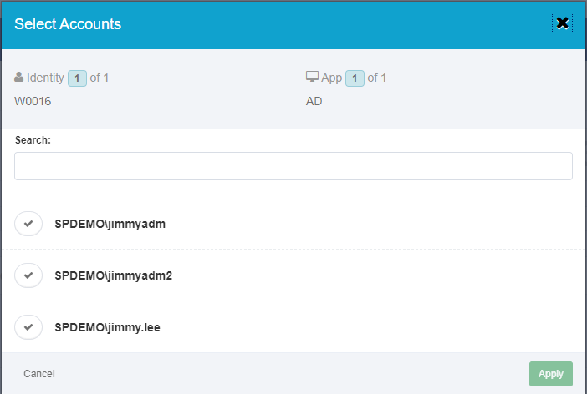
Search Filter on Selection Accounts Modal
Notes:
Here is the outcome. We will further test it in the demo session.

Slide 24
Manifest
Define the JavaScript snippets file, here we also includes the hashchange library.
Notes:
This demo plugin is quite simple, we simply need to put the javascripts under the snippets entry of the Manifest.

Slide 25
Ant Build: Plugin ZIP File Content
Use Eclipse to execute Ant build with target package.
The compiled package (.zip) is under build/ folder.
Notes:
And use Eclipse to build the plugin.

Slide 26
Demo

Slide 27
References
KOGIT Plugin Library
Source code used in this session is available on Developer Community post.

Slide 28
FAQ
Please leave your questions on Developer Community post.

Slide 29
Thank you!

