Slide 1
Workflows: Introduction & Roadmap
Thomas Burt Senior Product Manager - Platform SailPoint

Slide 2
Agenda
Workflows Introduction | A quick intro into SaaS Workflows and their components
Workflows Timeline | From GA to current – A timeline of improvements post GA
Workflows Future | What’s next short term & long term – A quick view into what’s next

Slide 3
Workflows Introduction
The what & why of Workflows

Slide 4
What are SaaS Workflows?
A means of orchestrating and automating undefinable tasks.
A sequence of steps that follow a logical path based on triggers, actions, and choices that can react to the data in the Data Flow, External Events, Timers, and Timeouts.
Notes:
SaaS -Workflows: When we say workflows, what we are talking about is applying security and governance to automation. Workflows, at its core, is an orchestration process that is initiated by some triggering event or change, consists of actions and choices based on the uniqueness of the data or events within the flow. IdentityNow already has the capability to automate tasks such as lifecycle management and access provisioning. These tasks are typically focused on clearly definable inputs. Workflows exponentially increase your value add by enabling the automation of tasks that are not as clearly definable. Tasks that require additional inputs, logic, external integrations and more. Workflows are a lynchpin in building out your autonomous IAM solution which is the foundation of Zero Trust practices.

Slide 5
Why SaaS Workflows?
Reduce Costs
Reduce Friction
Automate Manual Tasks
Focus on high value projects
Improve efficiencies for JML processes
Automate the removal of costly or risky access
Automate Onboarding tasks
Simplify reviews/certifications
Integration with non-managed applications, ITSM tools, & more
Automation is the key to scaling identity security. SaaS Workflows exponentially increases your ability to automate tasks that require the flexibility of additional logic, inputs, parsing, and complex calculations.
SaaS Workflows help organizations drive towards scalable Autonomous Identity Security
Reduce Risk
Autonomous Identity Security
Remove the Human factor
Re-Focus IT to high risk
Eliminate “Rubber-Stamping”
Automate remediation of outliers
Flexible automation combined with AI is the key to achieving Autonomous Identity Security
Notes:
Manual tasks can be extremely costly. In 2020, One of the major analyst firms investigated the average ROI for automating manual tasks specific to Identity and access management. This analysis was done by surveying a variety IAM customers across different industry verticals and assessing value based on the time and cost of IT admins. Their analysis found that, conservatively, automation of manual tasks produced quantified benfits with risk-adjusted present value of $10Million in the first 3 years alone. This included such benefits as moving to event/change based micro certifications, access tasks, and license cost reductions, just to name a few. An unstated cost was the benefit derived from refocusing IT teams on high priority projects that had been delayed due to time and resourcing diverted to manual tasks.
From a risk perspective, removing the human factor inherently reduces risk. Performing the same tasks repeatedly can lead to complacency. Overburdened IT departments tend to make riskier decisions in favor of productivity. Automating such tasks ensures your teams can focus on the high-risk IAM needs, eliminate “Rubber Stamping” through micro-certifications, and detect and automate the removal of outlier access risk. All of this leads to reduced friction in your organization by ensuring identities have Just Enough and Just in time access with focus on “Least Privilege”. Managers should be focused on your organizations productivity and goals, not on ensuring their direct reports have the right access. Certifications can be extremely time consuming. Focusing your teams on reviewing changes to access helps to reduce that workload. And finally, adding the ability to interoperate with non-managed applications, ITSM tools, and messaging services help ensure your focus is on your business not managing identities.

Slide 6
Workflows Components
What makes a workflow?

Slide 7
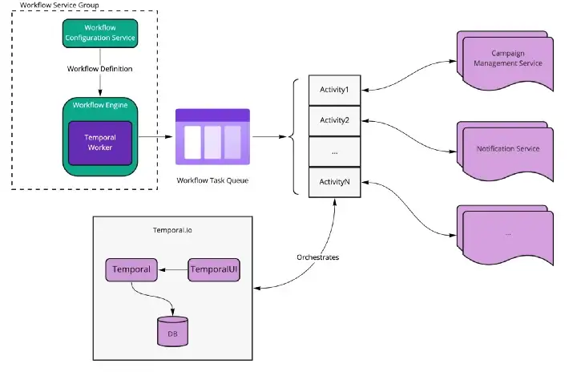
Workflows Architecture
Notes:
A Workflow Service Group which consists of
Workflow Config – The Workflow config service provides the CRUD operations for workflow definitions. Its primary purpose is to manage definitions for each tenant and support the validation logic that verifies workflow definitions syntactically and semantically. The workflow config service manages the subscriptions and filtering on triggers which provide the initial input to a workflow. The service is also responsible for managing the workflow definition lifecycle for things like version control and enabling or disabling a workflow
Workflow Engine – The workflow engine is responsible for the execution of workflow definitions. The engine contains the interpreter that walks the workflow and executes the instructions provided. This service is mostly a headless cluster that handles events from our kafka topics but it also supports a couple of endpoints where you can retrieve execution history and metrics for prior executions.
Temporal.io is the resiliency layer for the microservice orchestration.

Slide 8
Workflow Triggers
Triggers are used to define when and how a workflow is initiated
Provides initial date input to the workflow
All workflows must have one trigger
Triggers can be external, event-based, and time based
Examples:
Identity changes
Provisioning changes
Scheduled
External
Identity Attributes Changed
Notes:
To use this chart, right click and edit th

Slide 9
More on Triggers
Event Trigger Service (ETS) IDN services generate events on the event stream. Examples include when an identity is created, deleted, or an attribute changes. Other examples include Certification campaign events, Aggregation events, etc.. For more information on Event Triggers: https://developer.sailpoint.com/idn/docs/event-triggers
Workflows Registry – Workflows updates the registry dynamically to populate the trigger options in the Builder.
Fire & Forget
One-way communication with ETS Subscribers
Sole purpose is to forward the event to the subscribing service
Most Workflow Triggers are Fire & Forget
Request Response
Main difference is expectation of a response
Allows two-way communication between the service and the subscriber
Allows subscribers to receive and act on events in real time
Notes:
To be succinct Event triggers are the result of any activity performed in a service.
Workflows primarily use Fire & Forget Triggers due to the inability, pre-forms, to interact and provide a response to the service.
Examples of Fire & Forget Identity Created Identity Deleted Provisioning Completed
Aggregation Completed
Campaign activated
Examples of Request Response
Access Request Dynamic Approval
Access Request PrApproval

Slide 10
Workflow Operators
Operators are components which provide flow control based on the data, as well as delineating success or failure
Every Workflow must have an end-step
Multiple comparisons can be chained together
Operators can support AND, OR, & NOT when comparing values in a comparator *NOTE*
Examples include comparisons, loop, and success/failure steps
Compare Strings
Loop
Compare Numbers
End-Step – Success/Failure
Loop Operator
Notes:
Operators are basically choice steps that enable you to control the flow and branching of a workflow as the flow-data changes. Operators provide flexibility in comparing data that is in the data flow and making choices based on that data.
Every Workflow must have at least one operator, such as the "End Step" which terminates the workflow

Slide 11
More: Comparator with AND
Workflows support the ability to add AND, OR, and NOT operators when comparing values in a comparator step
{
"ChoiceList": [
{
"And" : [{
"variableA.$": "$.value1",
"comparator": "StringEquals",
"variableB": "one"
},{
"variableA.$": "$.value2",
"comparator": "StringEquals",
"variableB": "two"
}],
"nextStep": "Mutation"
}
],
"DefaultStep": "Fail"
}
Notes:
NOTE:

Slide 12
More: Comparator with OR
Workflows support the ability to add AND, OR, and NOT operators when comparing values in a comparator step
{
"ChoiceList": [
{
"Or" : [{
"variableA.$": "$.value1",
"comparator": "StringEquals",
"variableB": "one"
},{
"variableA.$": "$.value2",
"comparator": "StringEquals",
"variableB": "two"
}],
"nextStep": "Mutation"
}
],
"DefaultStep": "Fail"
}

Slide 13
More: Comparator with NOT
Workflows support the ability to add AND, OR, and NOT operators when comparing values in a comparator step
{
"ChoiceList": [
{
"Not": {
"variableA.$": "$.value",
"comparator": "StringEquals",
"variableB": "public"
},
"nextStep": "Mutation"
}
],
"DefaultStep": "Fail"
}

Slide 14
Workflow Actions
Actions are the core building blocks of workflow to perform certain tasks – within SailPoint in an external system such as an ITSM Tool
All workflows must have at least one action
Each action can interact with data in the workflow (additive)
Each action has a configuration specific to that actions behavior
Examples include interactions within SailPoint or externally with other systems
Manage Accounts/Access
Send Email
Send Slack
Manage ServiceNow Ticket
HTTP Request
Manage Access Action
Notes:
Actions are the real meat of the workflow and are the core building blocks you will use to initiate operations based on the flowdata. Examples include notifications (email, slack, other) creating certification campaigns, managing accounts and access, integrating with non-managed applications such as ITSM tools and more.
Each action has its own user-friendly guided configuration. Similar to triggers and operators, each workflow must have at least one action. Each Action can interact with the data in an additive approach meaning actions that add new data to the dataflow can enrich follow on actions in the workflow Each action has configuration related to its specific behavior

Slide 15
Workflows Timeline
2022

Slide 16
Workflows Timeline
Q1 - 2022
Open Beta Sandbox only
July 1, 2022
Workflows released to GA
Basic JML capabilities
Basic Notifications (email)
Q4 2022
Performance & reliability
Looping
Inline Variables
Slack Action
ServiceNow Action
Closed Beta
Q3 2022
Open Beta
GA – July 1, 2022
Q4 2022
Q3 2022
Closed Beta
UX/UI focus
Q3 2022
Templates
Test Workflows Improvements
Trigger Filtering
Trigger improvements
Outlier Detection Template
Action & Operator Improvements
Custom Schema Support
Notes:
We made a significant pivot in the beginning of 2022 to focus on capabilities but also usability. The prior focus required a deep knowledge of JSON Path which most customers were not adept enough to build meaningful workflows. While we knew we needed to continue to add additional capabilities, beta feedback clearly indicated we needed to pivot to a focus on Usability.
In Q2, we continued our usability improvements while focusing our efforts on the minimum viable capabilities for JML worklflows to meet our deadline for GA at the beginning of Q3. We closed the open beta and opted for a more personalized “Closed Beta” where we were in direct contact with participants to ensure the changes and focus for JML would be met in time for GA.
In Q3 we released workflows to GA with a primary focus on the JML workflows that saw actions such as notifications, certification campaign activities, and some access capabilities Q3 was a very production quarter that also focused on adding more capabilities like testing improvements, allowing for Trigger filtering with complex operators, adding support and building templates starting first with JML then following quickly with cross product templates such as Outlier detection. We also added support for all schema in the identity cube including custom schema.
Q4 was primarily focused on shoring up backend capabilities around performance and resiliency however we also completed work to shore up use cases that required looping capabilities, inline variable support, and new actions.

Slide 17
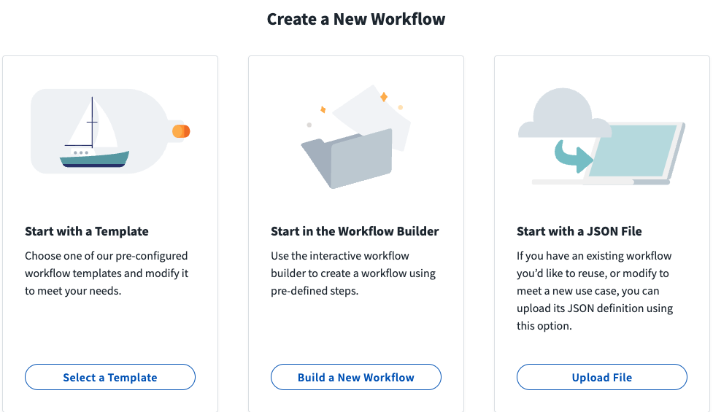
Q3 -2022 Templates
Templates
Intended as a guide for customers to use out of the box or add their own customizations to meet their specific business needs by category.
Notes:
Templates were added with the intent of giving customers a guide to follow for specific use problems.
Our first set of templates were focused on JML
Follow on templates include 3 for Outlier detection integration as well as SaaS management

Slide 18
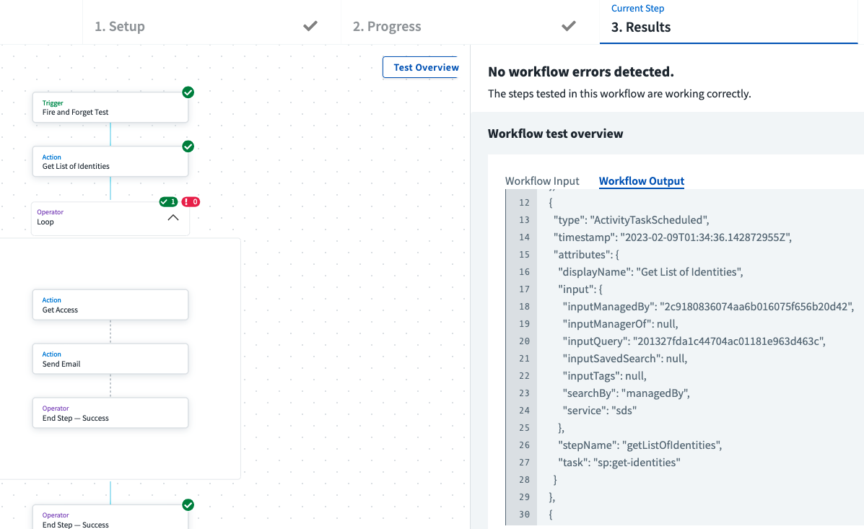
Q3 – 2022 Test Workflow
Test Workflow Improvements
Improvements to the ”Test Workflow” which help accelerate time to enabled.
Notes:
Testing improvements included a guide to tell you where in the test the workflow is, improvements to manage the test input, improvements to the Workflow Input & Output.

Slide 19
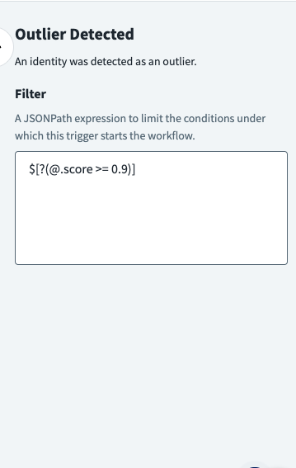
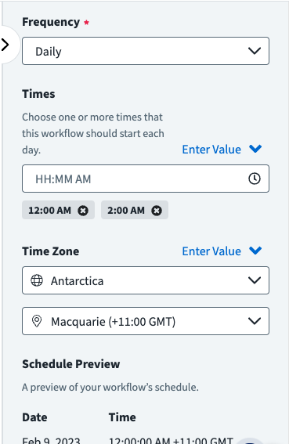
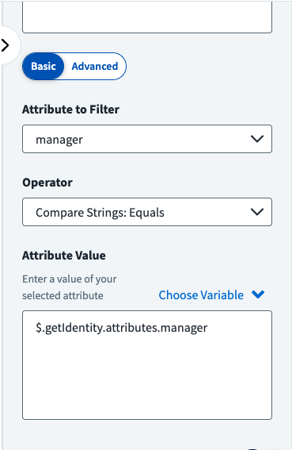
Q3 – 2022 Triggers
Trigger Filtering
Trigger Improvements
Scheduled
Trigger Improvements
Identity …
Notes:
Testing improvements included a guide to tell you where in the test the workflow is, improvements to manage the test input, improvements to the Workflow Input & Output.

Slide 20
Q3 – 2022 Custom Schema
Notes:
We added the ability to select all schema attributes from the identity cube (prior to this it was standard schema only) including custom schema attributes. If it exists, we can select it in the UI/UX

Slide 21
Q3 – 2022 continued
Some additional improvements in Q3
Improved Operator functions
Improved Action capabilities including net-new action version capabilities
Performance improvements to backend services

Slide 22
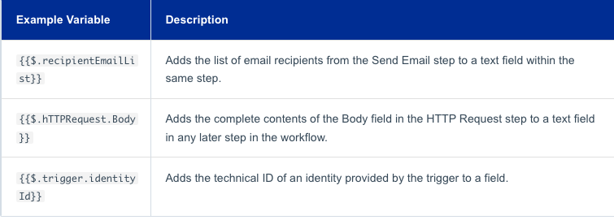
Q4 -2022 Inline Variable support
Inline Variables
The ability to reference data as a variable anywhere within the workflow.
Format:
{{ $.stepName.variableName}}
Notes:
Most fields in workflow steps and actions required you to enter a static value or choose a variable from a prior step to use as the complete value for the field. In fields that accept text values, you can choose to inclue a variable from the data in the workflow data flow in your static text value using Inline variables.
You can add inline variables to any field that uses a string input.
Examples: Use an inline variable to reference the users name in an email or the values returned from Get Access. You can also add an account name to the body of a HTTP request step.

Slide 23
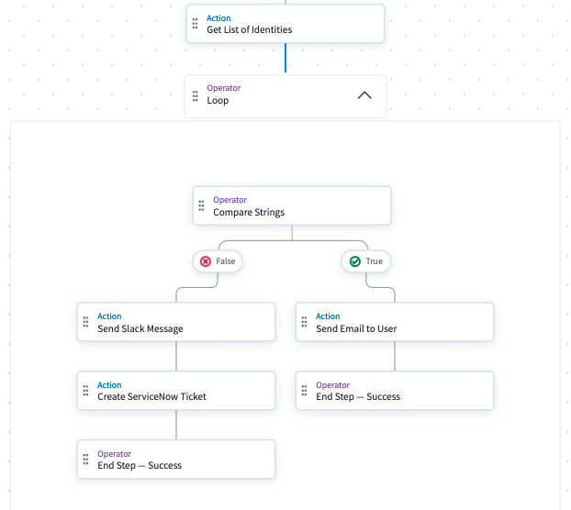
Q4 -2022 Loop operations
Looping
The ability to iterate through a list of data in the workflow data flow with their own separate actions. Think of Looping as initiating child workflows where each loop.input is evaluated through each of the steps.
Notes:
For certain actions where there are numerous results like Get Access, Get Accounts, Get List of Identities, or even external actions like the data sent from an external source, customers needed the ability to apply logic and flow for each one of the items in the array or list. Looping solves this problem by allowing you to define data flows and actions based on the uniqueness of each item passed into the loop.

Slide 24
Workflows Roadmap 2023
What’s Next?

Slide 25
Workflows Roadmap 2023 **NOTE: All roadmap timelines are subject to change
Q1 2023
Context for loops
Dynamic variables (Phase 1)
Forms Action
Extended Execution Logging
Simulated Testing (Phase 1)
Q3 2023
Dynamic Approvals
Improved forms integration
Cross Product workflows
Template Improvements
Support Task Reassignment
Q2 2023
Q4 2023 & Beyond
Q1 2023
Q4 2022
Q2 2023
Dynamic Variables (Phase 2)
Workflows Versioning
Forms Improvements
Simulated Testing (Phase 2)
New Actions
Powershell
WriteBack
Generic SP API
Q4 & Beyond
Dynamic Approvals cont.
Task Reassignment cont.
Connectivity integrations
Data Intelligence integrations
Automated workflows
Dynamic integrations

Slide 26
Q1 -2023 Loop context
Looping context
The ability to pass into and reference more data from the workflow data-flow.
"Loop": {
"actionId": "sp:loop:iterator",
"attributes": {
"context.$": "$.getIdentity.attributes",
"input.$": "$.trigger.changes",
"start": "Send Email",
Notes:
The Loop operator takes the input from the action immediately prior to the Loop operator. This loop input is specific to the last action, i.e. Get List of Identities above. In January we released a code option to specify additional context to pass into the loop.
End of Q1, we will have a UI component to edit the context. Currently the editing requires that you edit the JSON directly

Slide 27
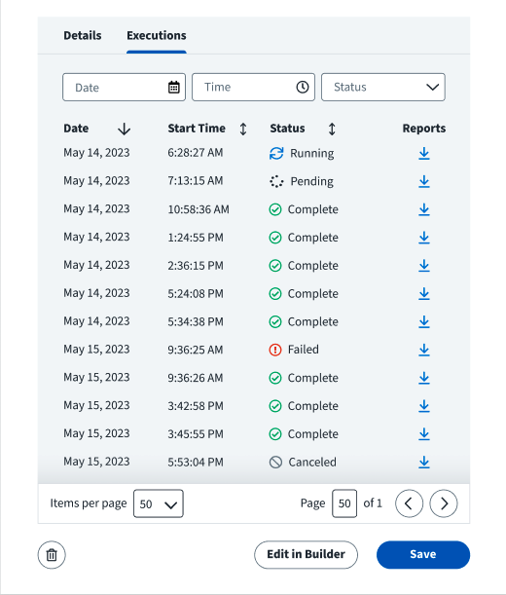
Q1 -2023 Execution Logging
Goal Experience Design
Execution Logging Improvements
Execution logging has been persisted to 90 days from 48 hours.
Notes:
As mentioned earlier, we utilize temporal.io as the resiliency and orchestration layer for worklfows. One piece of that is managing the execution logging. Temporal.io limits persistence of these execution logs to 48 hours which presents problems for customers that have need to review a workflow that failed past 48 hours. We have created an enhancement to the execution logging where we can store and persist these logs for 90 days thus ensuring customers have time to review the logs of any workflow execution. This capability will be live by the end of February with a follow on UI/UX update that allows you to paginate and filter on the execution logs.

Slide 28
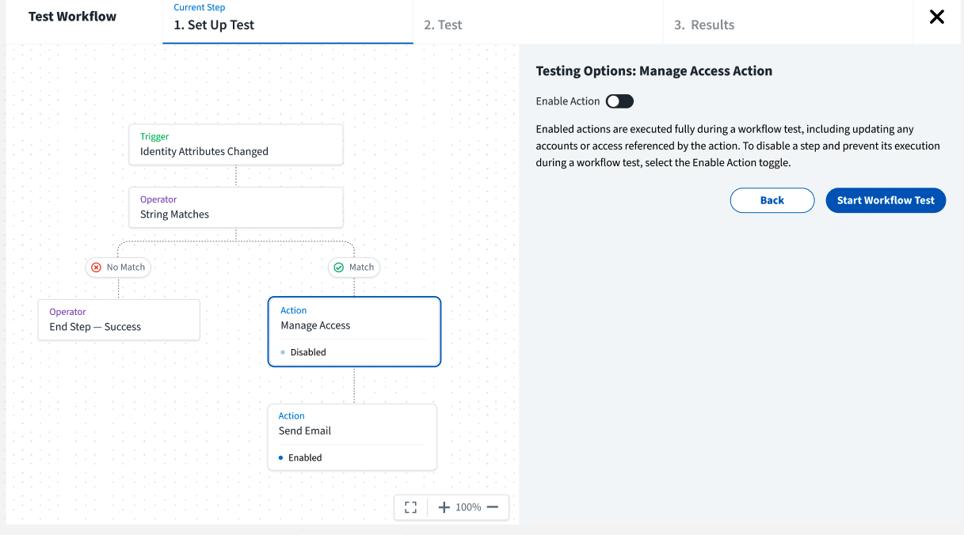
Q1 -2023 Simulated Testing
Goal Experience Design
Simulated Testing for actions and loops
Test Workflow will have the ability to toggle on or off actions and loops the simplify testing of workflows and thus speed time to value.
Notes:
Test Workflow is a means of ensuring the workflow logic and configurations work as expected. One downside to the Test Workflow is that it currently executes the actions. Actions like Manage Access and Manage Accounts could potentially cause unwanted outcomes if, by example, you are testing a workflow and accidentally remove all access or delete an account. Loops could potentially cause the Test Workflow to take longer than wanted.
In Q1, we will provide a means for users to select whether or not to execute the actions as part of a test. If the user decides to “Simulate” the action, they will have sample dummy data that can be edited/modified and pass into the rest of the workflow.
We took the choice to add simulation to all actions first with an initial focus on Manage Access, Manage Accounts, and Create Certification Campaign. Follow on actions will come in the future. In addition, we will eventually add the ability to skip the Loop in the test action.

Slide 29
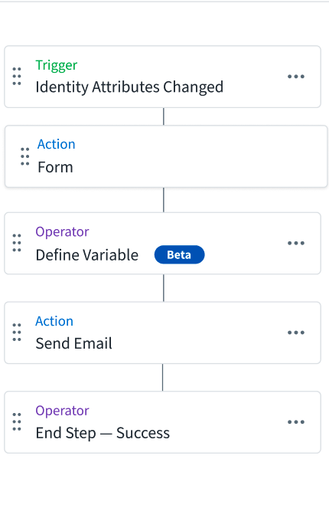
Q1 -2023 Custom/Dynamic Variables
Dynamic Variable support
The ability to define custom variables from existing data within the workflow.
Initial Target - String
Secondary - Date
Notes:
Building on the ability to define and reference data in variables, we are building the capability to define custom variables. The first target is string data followed quickly by date variables that can be used and referenced anywhere in the data flow.
Examples – String I want to build an email address out of existing values. Using Get Identity, I gather the users first name and last name. In the custom variable builder, I choose the data values and apply operators such as “First letter of FirstName”, Plus Static text of a dot, Plust “Full lastName” Plus static text such as @domain.com
This value can then be used to “eventually” write back to a new attribute in IDN or used in other actions.
Date – I have a workflow that will create a certification campaign and notify the owner via slack, email or teams. In that notification, I want the user to know that they have X days to complete. While the Campaign deadline can be referenced, I want the reviewer to make sure they complete at least 1 week prior to the deadline. I create a custom variable to take the deadline date and subtract 1 week. The notification then references the new value and adds it to the message.

Slide 30
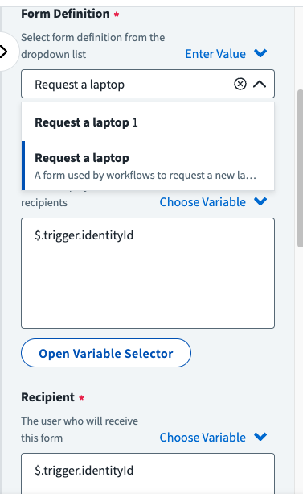
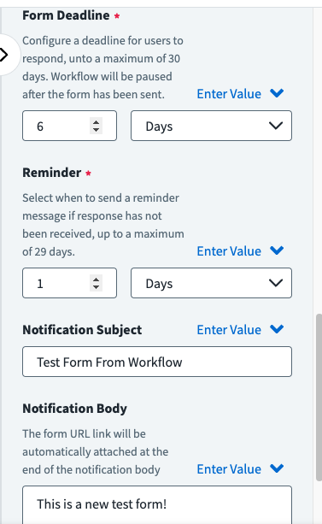
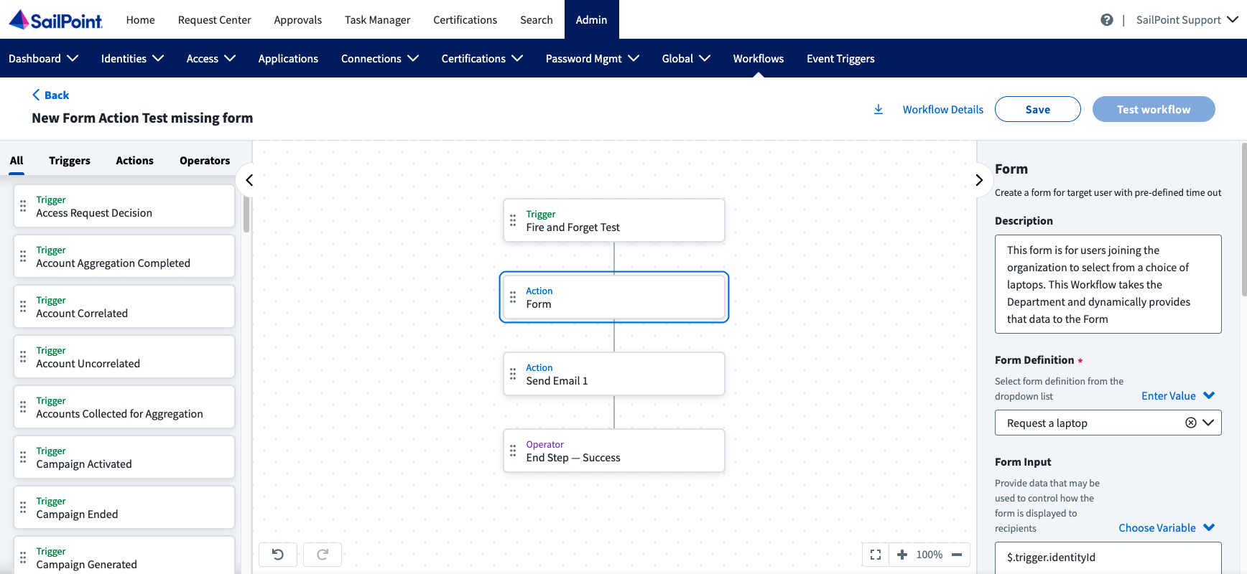
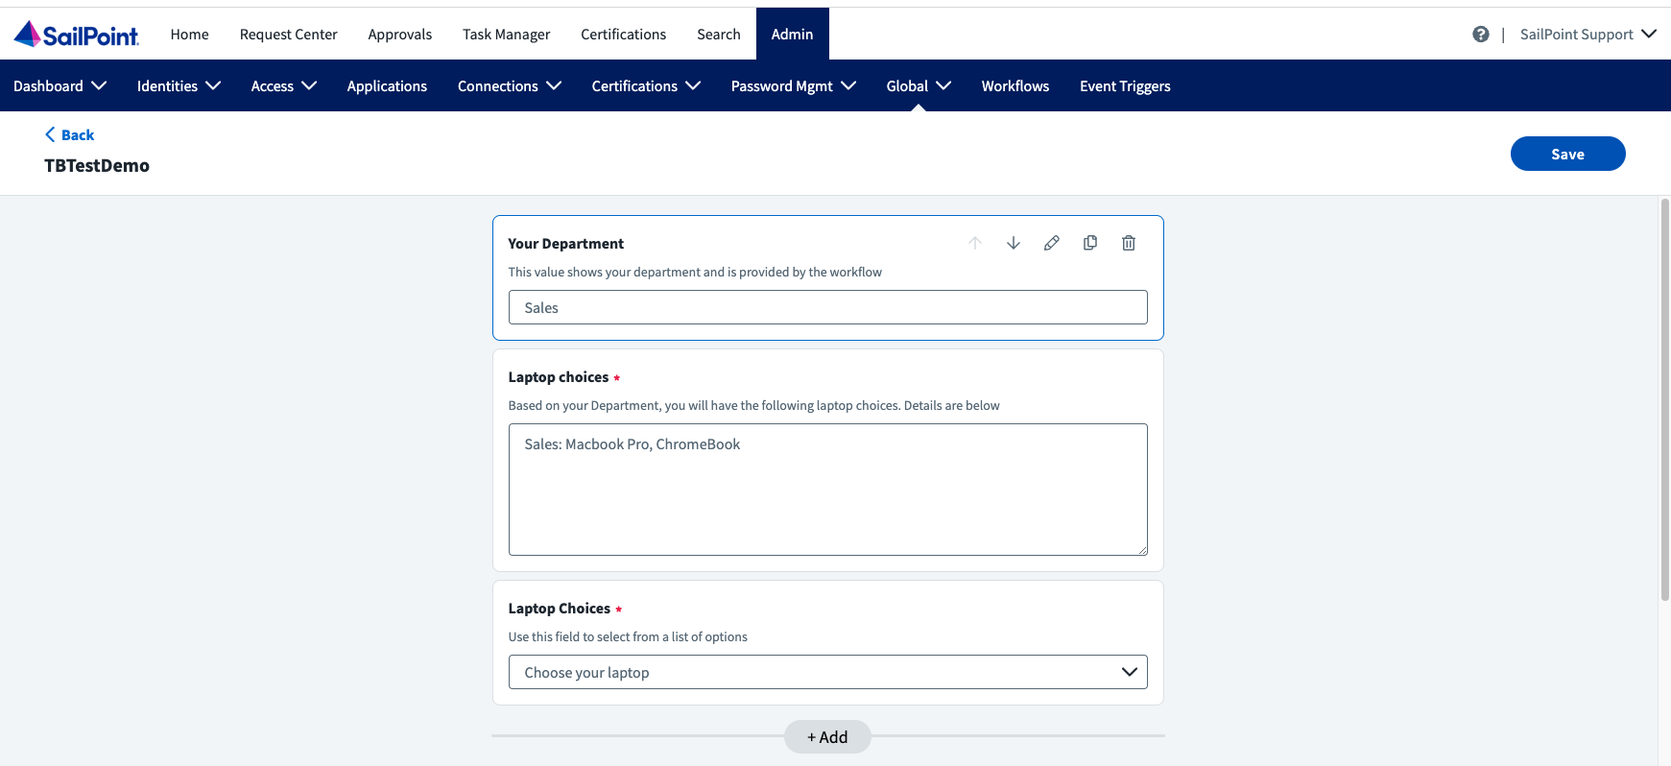
*Q1 -2023 Forms – Closed Preview
Custom Form support in Workflows
Form Action and integration with Custom forms to ingest interactive data into the data-flow of workflows
Notes:
Custom Forms are being developed for cross product capabilities including Access Requests, Workflows, other….The first consumer of custom forms will be workflows.
We plan to ingestion points Triggers & Actions
By the end of Q1 workflows will have the ability to reference a form, send that form as part of a workflow action via notifications including deadlines and reminders, pause the workflow until the form is submitted or the deadline is reached, and reference the data submitted as part of the form for use in the data-flow of the workflow.

Slide 31
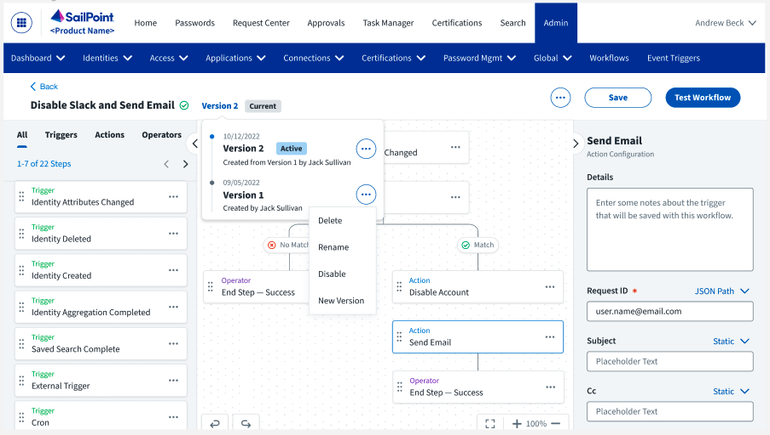
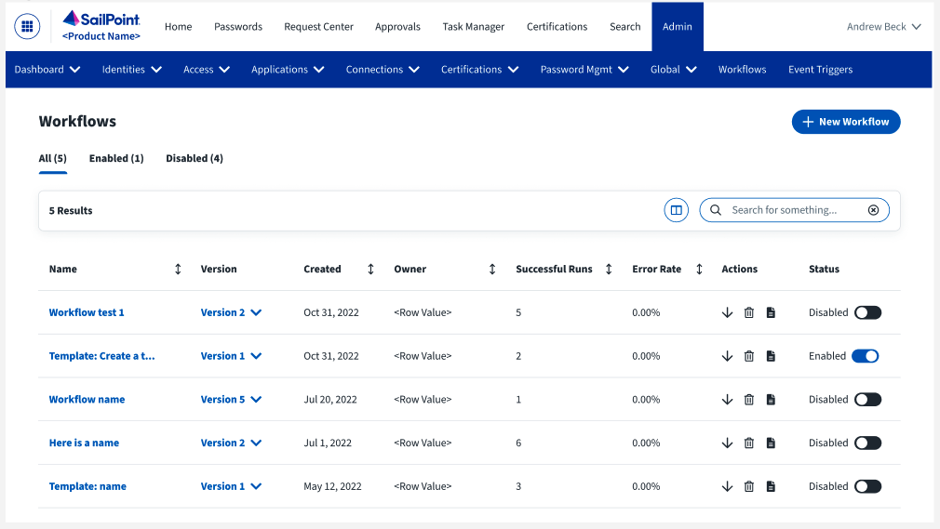
*Q2 -2023 Versioning
Version support
Version support enables users to Manage, Create, and Revert to prior versions of workflows ensuring resiliency in workflows
Notes:
Workflow versioning is intended to add value by ensuring you can track changes in workflows including the ability to revert to a know working version. Currently, if you want to modify a workflow you need to disable that workflow (Potentially missing events) make your changes, and re-enable. One problem versioning solves is to enable customers to create a new version of a currently enabled workflow thus ensuring no events are missed.

Slide 32
*Q2 -2023 New Actions
New Actions - PowerShell
A dedicated action for users to reference externally stored PowerShell scripts and use the webhooks to invoke commands while passing in data from the workflow data-flow
New Actions - Writeback
A dedicated action that allows users to update or add attributes in the IDN Identity Cube.

Slide 33
Autonomous IGA / IAM
Future of Workflows Most organizations have unique business challenges specific to their needs. SaaS Workflows means your organization can solve an almost infinite number of use cases. SaaS workflows flexibility and usability enables you to solve these challenges. Leveraging the power of AI, the future of Autonomous IGA is unlimited
Examples:
Identity Insight automation
Role Insight automation
Unmanaged Application onboarding
Risk / SIEM / CIAM integration
Workflow generated Workflows
©2022 SailPoint Technologies Holdings, Inc. All rights reserved.
33
Notes:
The future of workflows and IAM is Autonomous IAM: Zero trust practice is built on a foundation of Identity and Access Management. Autonomous IAM is the means of automating manual tasks reducing the risk and cost of manual processes. SaaS Workflows coupled with Data Intellligence, other suites products, SIEM/CIAM tools, and more means you can quickly move towards Autonomous IAM freeing your IT staff to focus on higher risk challenges or high impact projects.
The future is wide open, any repeatable manual task can and should be automated to reduce risk and ensure compliance.

Slide 34
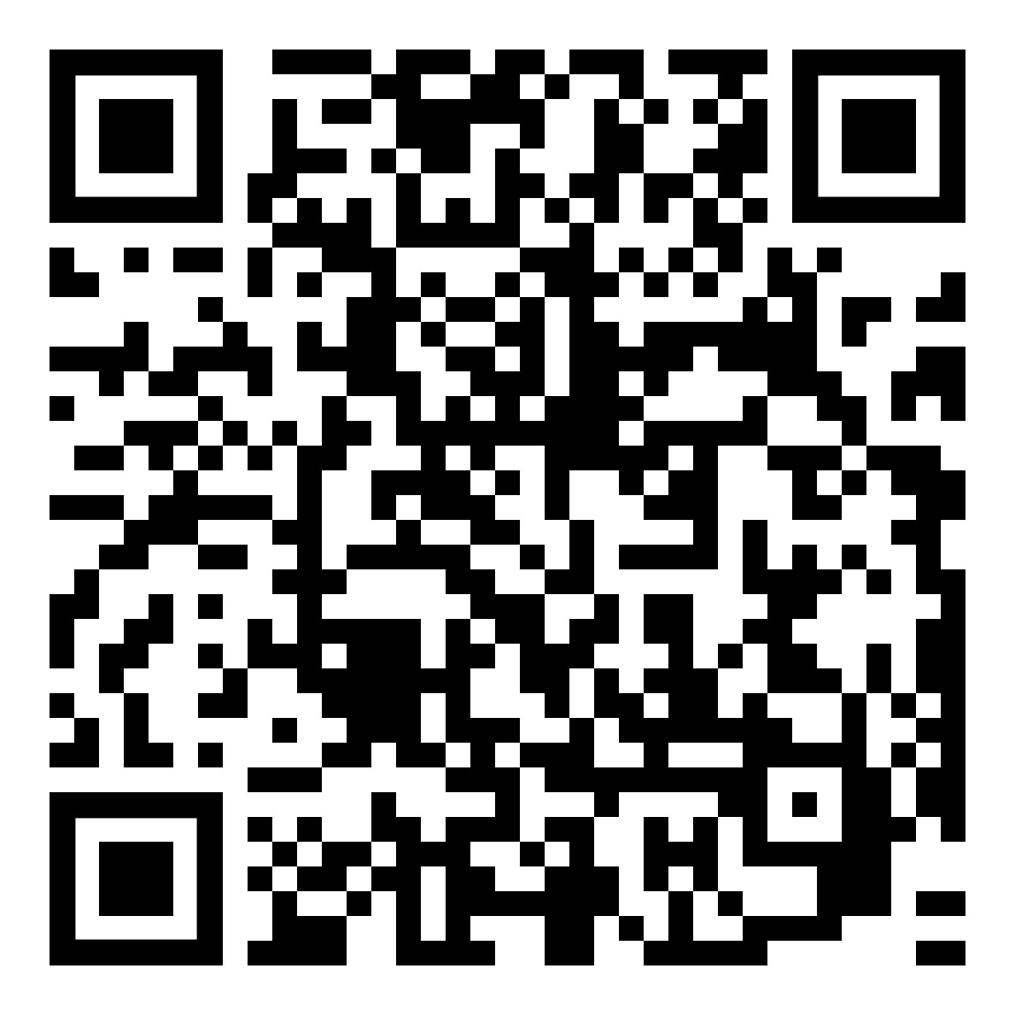
Your Feedback Matters
How can I provide feedback?
In product – ”Provide Feedback” option
Direct PM & UX Research
Developer Community
SailPoint Compass Ideas
Live Feedback with PM

Slide 35
Thank you!

