Slide 1
Forget the GUI, Embrace the Shell!
Speaker: Derek Brown Title: Sr. Identity & Security Engineer Company: Lincoln Financial Group

Slide 2
THE DON’T YELL AT ME PART

Slide 3
DISCLAIMER!
This Module is a generic version of the one I wrote for use at Lincoln. I removed sections/functions written specifically for Lincoln and made everything as generic as possible. I’ve tested a lot, but I’m sure there are still some kinks to work out.

Slide 4
THE BORING PART

Slide 5
New PowerShell Module for IdentityNow
No config files required
Easy switching between Tenants
Organization Names are set as Environmental Variables.
Instance Parameter on all Functions lets you easily switch between your Production and Sandbox environments.
GitHub:
https://github.com/dmbrown1386/IdentityNow-Module
PowerShell Gallery:
https://github.com/dmbrown1386/IdentityNow-Module
Predefined search criteria
Classes do the heavy lifting
Parameters for common attributes make basic searches quick and easy.
Let the code do the work. Functions leverage Classes to build the more complex JSON bodies.

Slide 6
Getting Started
A script runs each time you Import the Module to check your Org Names have been set.
If one or both are missing, you will see warning and will be prompted to select to create the missing variable(s) as a User or System Variable and then provide the missing name(s).

Slide 7
Authentication
Authentication is easy!
The only supported Authentication Method is Client Credentials with a Personal Access Token (PAT).
The Get-IdnToken Function will create the variable with your Token and the Base URLs for your Production and Sandbox Tenants.
Pass your Client ID as a string and your Secret as a Secure String to the function, and that's it!
This keeps you in control of your credentials.
Store and Extract them from any secure location available

Slide 8
Tenant Selection
The Instance parameter is used to select which Tenant to run the Function against. The Get-IdnToken function will create a variable with the Bearer Token and the Base URLs for the selected Tenant.
All other Functions use the Instance Parameter to select the Variable for the Chosen Tenant. The default value is Production.

Slide 9
THE FUN PART

Slide 10
Running Searches
The Search Function has some canned searches for Identity Attributes that are fairly universal
First and Last Names
Email
Email Domain
Lifecycle States
Also supports submitting a custom Search if the prebuilt options don't meet your needs.
Parameter sets will keep you from mixing up searches intended to return single Identities or multiple Identities.

Slide 11
Search Examples
Canned Search
Custom Search

Slide 12
Creating Transforms
Classes for the various Transform Operations insure you provide the right criteria to build a valid Transform
The Initialize-IdnTransformRule Function uses Switches to select what Operation your Transform is for.
Parameter Sets insure only options relevant to the selected Operation are presented.
Anything that’s required is tied to Mandatory Parameter
Use New-IdnTransformRule to send the Transform you created to your IdentityNow Tenant.

Slide 13
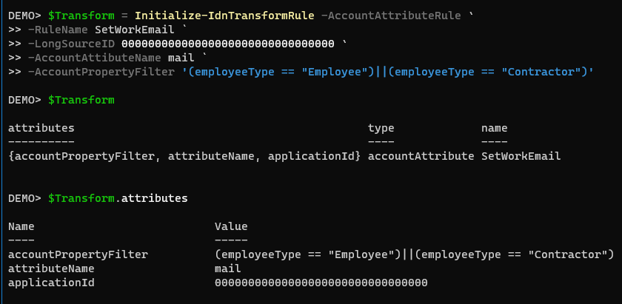
Transform Examples
Set Work Email
Oops!!

Slide 14
Adding Identity Attributes
Classes for the various Transform Operations insure you provide the right criteria to build a valid Transform
The Initialize-IdnTransformRule Function uses Switches to select what Operation your Transform is for.
Parameter Sets insure only options relevant to the selected Operation are presented.
Anything that’s required is tied to Mandatory Parameter
Use New-IdnTransformRule to send the Transform you created to your IdentityNow Tenant.

Slide 15
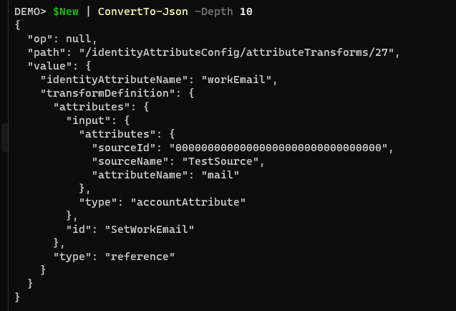
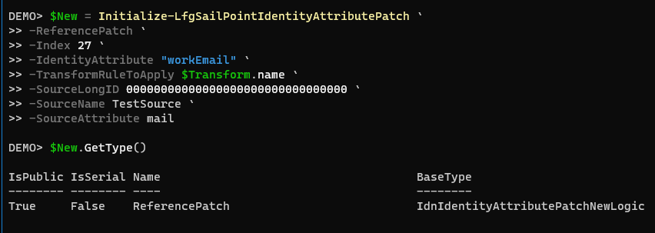
Screenshots
Initialize Function
Converted to JSON

Slide 16
Updating Role Criteria
The Add-IdnRoleCriteria Function will prompt you for everything you need to add a new clause to an existing Role.
Validate Sets are used to require valid options are entered for Type and Operation.
The Function will build the JSON for you and add it to the end of your existing criteria.
The output on the next slide is for demo purposes only.
This is intended to show you Class this function builds
Running this command will create this, but also add it.

Slide 17
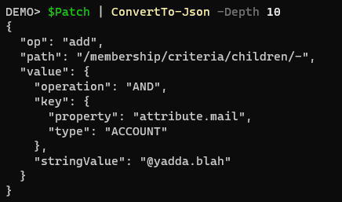
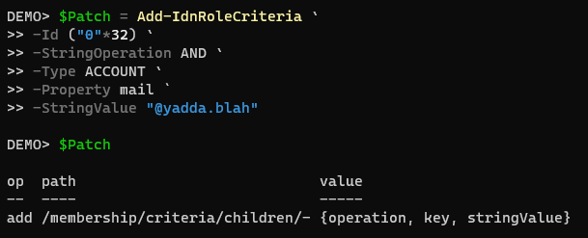
Screenshots
Command and Demo Output
Converted to JSON

Slide 18
Other Cool Things
The Get-IdnRole command has the option to Expand the Access Profiles.
With this Switch set the basic list of accessProfiles returned is replaced with everything.
Get-IdnIdentityProfileIdentityAttributes adds a Note Property for the Index giving you its numeric position in the list.
Need to know where your new Identity Attribute should go, this makes it REAL easy.
Set-IdnRoleCriteria is a cool idea (at least I think it’s cool), but I need a better way to include it.
The Idea is to Use Switches and Parameter Set Names to easily update the Criteria for your Roles.
For me this was useful during a Project, but I haven’t used it since it ended.

Slide 19
THE NOT DONE YET PART

Slide 20
More Transform Classes
Add Missing Transform Operations
Add Stacking for Multiple Operations
I’ve got my work cut out on me with this one, SailPoint gave us a lot of Options here, but worth the effort. If the Operation is missing now, I’ll add it eventually. I’m open to taking a poll to get a priority list going, thoughts???
One reason I have Creating the Transform separate from Adding it add support for stacking different Operations. Sometimes you need to lookup and manipulate. This approach also makes it easier to build Transforms for First Valid and Lookup Operations.

Slide 21
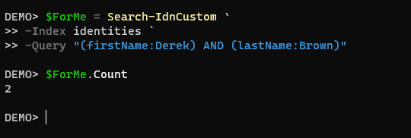
Additional Search Functions
Search Functions for all Indices and more Parameters
Not all Indices have a function yet. Finishing those is on the list, but the Search-IdnCustom let’s you pick your Index and send your own query

Slide 22
Dynamic Roles
Adding New Criteria is great…. but....
I hear you. Maybe you need to remove a clause or create a brand New Role from scratch and don’t want to run multiple commands. Me either, which is why it’s on my list.

Slide 23
Dynamic Roles
Adding New Criteria is great…. but....
I hear you. Maybe you need to remove a clause or create a brand-New Role from scratch and don’t want to run multiple commands. Me either, which is why it’s on my list.

Slide 24
Sources
I think it would be awesome to have a Class/Function combo to create a Source and capture everything you need…. but that’s a tall order. There are a lot of options

Slide 25
Old APIs
I’m long overdue for an audit on functions using the Older API versions. V1, V2 and CC all need updated where possible, but I think the modern APIs are still short in a few areas. I’m very open to feedback here.

Slide 26
Questions, comments… criticisms???

Slide 27
Thank you!

