Slide 1
IdentityIQ Plugin Development
speaker: Adam Creaney; title: Sr. Manager, Technology Alliances; company: SailPoint Technologies;

Slide 2
Agenda
What is the Plugin Framework? | Adam
What are the components of a Plugin? | Adam
Quick word on Support | Adam
Demo | Adam

Slide 3
What is the Plugin Framework
Plugins and what the framework provides

Slide 4
First – What is a plugin?
An extension to the core product that adds new capabilities or functions to the core IdentityIQ platform
Code manifests that install on top of the plugin framework

Slide 5
The Plugin Framework is…
Part of the product
Introduced in 7.0 as an extension, fully productized in version 7.1
Designed to allow for rapid innovation on the IdentityIQ platform

Slide 6
The Plugin Framework Provides…
Installer framework
Custom REST endpoints and background services
Persistence model
User interface customizations

Slide 7
Technical Components

Slide 8
What makes a Plugin?
Manifest File
Build File
Database Scripts
Java Classes
XML Artifacts
UI Elements

Slide 9
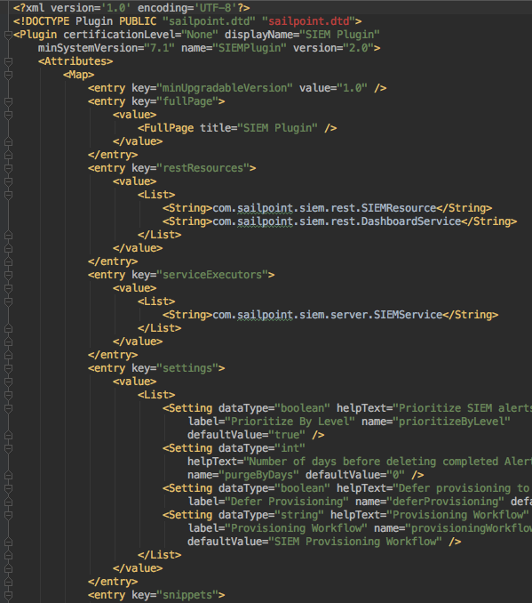
Manifest File
XML representation of the Plugin
Contains all the obvious parameters required by the Plugin
Name
Associated REST Resources
List of executor classes
Snippet regex and links to logic
Plugin specific settings
Full page reference
Required rights to view
Addition meta-data for the Plugin
Date of installation
Versioning

Slide 10
Build File
Simple Apache Ant file
Contains external references to properties file to specify class dependences for Java compilation
Looks for components in very specific locations – file structure is important!
Process:
Creates a ‘build/dist’ directory
Compiles Java classes and creates .jar
Creates archive of .jar file, and any XML objects, db scripts, UI components
Final product is a .zip file in /dist ready for installation!

Slide 11
Database Scripts
Plugins get their own database in IdentityIQ (by default identityiqPlugin)
Default user/credentials also created – specified in iiq.properties
Scripts can be included to instantiate the database when a plugin is installed
Scripts can also be included to remove the data when a plugin is removed (careful!)
Full control over table naming, schema, and indexing!

Slide 12
Java Classes – REST Resources
Custom REST resources extend BasePluginResource, which has
Methods to access plugin settings from manifest.xml
Methods to get JDBC connection to plugin database
Methods to facilitate creation of secure prepared statements
Authorize method stub, which can/should be customized
Define custom methods implementing HTTP methods (get/post/delete/etc)
Access to these endpoints is limited by the authorization scheme defined by implementer (i.e can limit it by capability/spright etc…)

Slide 13
Java Classes – Executors
Extends a BasePlugin class (Service/Task/Policy), which provides accessors to
Plugin settings
Plugin database connection
3 Types
Service
Task
Policy
Background Process
Execution frequency defined in ServiceDefinition xml
Similar to normal task, but custom logic
Can be scheduled/executed using associated TaskDefinition xml
Create custom policy evaluator and create violations

Slide 14
XML Artifacts
These can be any IdentityIQ object that is required for the plugin
Most common are
SPRight objects for custom authorization
Service definition, task definition, or policy objects associated with plugin java classes

Slide 15
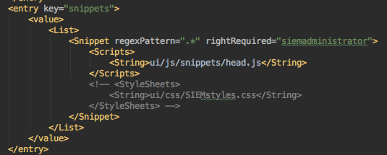
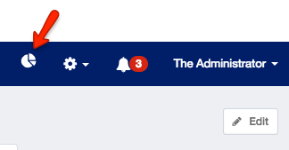
UI Elements - Snippets
Snippets allow for code modification/injection into IdentityIQ pages, and can be applied to specific users via SPRights
A snippet is defined by:
Regular expression – this is a REGEX that will be matched against the URL of an IdentityIQ page – if the URL is matched, the Snippet is fired
Script – can be any javascript
Commonly use jquery to find elements on page, and insert additional logic

Slide 16
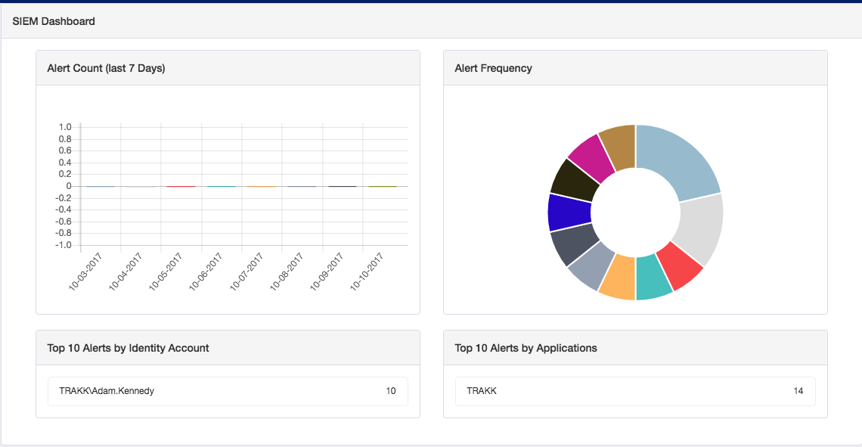
UI Elements – Full Page
Gives ability to have plugin specific landing page in the IdentityIQ application
Full control over look and function
Can use popular web frameworks including Angular
IdentityIQ 7.2 comes with package of SailPoint defined elements, for better look/feel integration of custom components
Example w/Angular charts

Slide 17
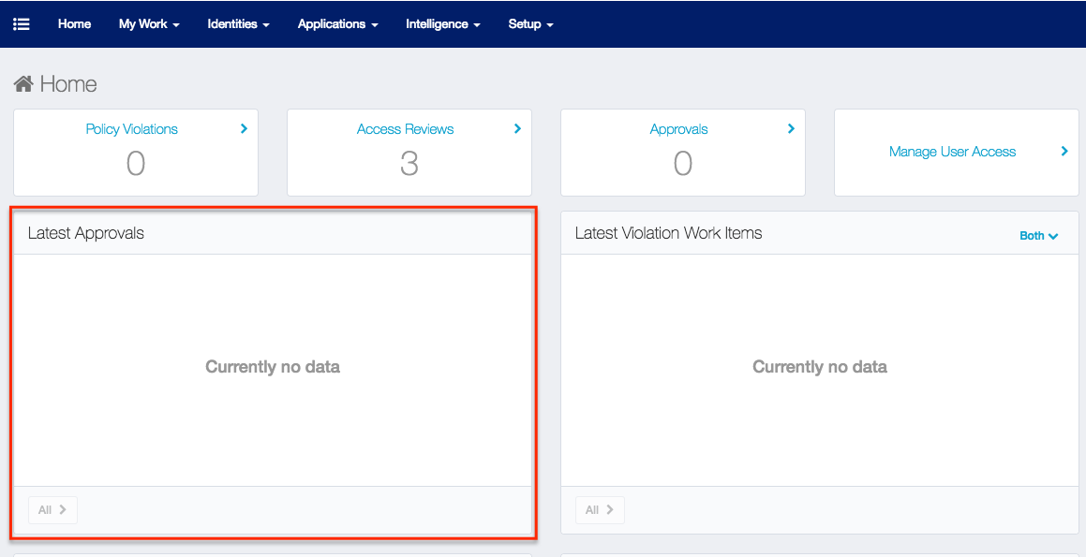
UI Elements - Widgets
New to IdentityIQ 7.2
Ability to create custom widgets on IdentityIQ dashboard
Create one of these!

Slide 18
Some final thoughts…
IdentityIQ classloader and the Plugin classloader are *different*
Normal workflows/rules/logic in IdentityIQ do not have access to classes loaded via a Plugin Framework
Plugins are loaded (cached) on install or server restart. Location of the cached resources is the base url + plugin/{pluginName} followed by the path in the build structure
When a plugin is removed, currently the XML objects imported are *not* deleted. The entry for the plugin is removed, the persisted file is removed, and the scripts associated with the delete action are run
7.0 plugins are not compatible with 7.1, and 7.1 plugins are not compatible with 7.0
UI modifications done via plugin snippets may still break after an upgrade, if the DOM model has changed. Intended so that only the plugin breaks, not the core product page

Slide 19
Plugin Support

Slide 20
Plugin Support Model
Plugin framework issues are supported through normal SailPoint support channels
Plugin specific issues are supported by the developer

Slide 21
Additional Information
Plugin Developers Guide - https://community.sailpoint.com/docs/DOC-7562
Open Identity Platform Developer Program - https://community.sailpoint.com/groups/development-partnership-program
TODO Plugin Example - https://community.sailpoint.com/docs/DOC-9276
Plugin Center - https://community.sailpoint.com/community/plugins
IdentityIQ 7.2 Release Notes - https://community.sailpoint.com/docs/DOC-9405

Slide 22
Demo
Let's create a new API Endpoint!

Slide 23
QA/Discussion

Slide 24
Thank you!

