Slide 1
Who are you supposed to be?
Or: Matching and Merging Identities in a Multi-Source Environment
Mark Earnest Principal Consultant Identity Works LLC

Slide 2
The Challenge
Matching Logic
Manual Matching
The matching logic must be flexible enough to support multiple rules covering multiple attributes and “fuzzy logic”
Processes and an interface must exist to handle cases where a positive match cannot be programmatically determined
Environments where an identity exists in multiple authoritative sources, lacking a foreign key for correlation between them and imperfect data to build correlation rules.
An example of this is a higher education environment with an HR system, multiple student systems, alumni systems, etc.
Performance
Auditability
The solution must frequently accommodate many new records as well as allow for fast resolution of manual matches
Matching decisions made, by the algorithm or manually must be tracked and auditable

Slide 3
Alternative Approaches
MDM Software
Manage IDs separately
Reactive Matching
Informatica
LumenData (Partnered with Oracle to create software specifically for Higher Ed)
Homegrown Identity Registry (common in Higher Education)
Different usernames, accounts, entitlements, etc. based on affiliation
End user nightmare, but still done in some environments
Best effort auto-matching with bias toward creating new accounts
Have manual process in place to merge accounts when necessary
Manual, slow, human resource intensive, but still done in places

Slide 4
This Approach
Matching and Merging Plugin
Distills identities from multiple authoritative source down to a single identity object
Contains logic for multiple source matching
Pluggable framework for defining matching rules
Callable from any authoritative source’s correlation rule
Supplies UI for manual matching and merging
Notification
Delegated Administration
Audit Events
Utilizes native IIQ objects (custom, identity, link) as well as IdentityIQPlugin tables for additional match metadata

Slide 5
Rationale For This Approach
Desire to move away from homegrown and/or disconnected solutions
Several advantages to having provisioning tool directly connected to sources rather than mediated via third party solution
Preferred end user experience in maintaining single identity/logon with university
Single interface for accounts management team/helpdesk to cover all aspects of account creation
Manual matching and merging interface benefits from close UI and data proximity to the IAM tool.
Ability to utilize existing matching/merging logic
Performance

Slide 6
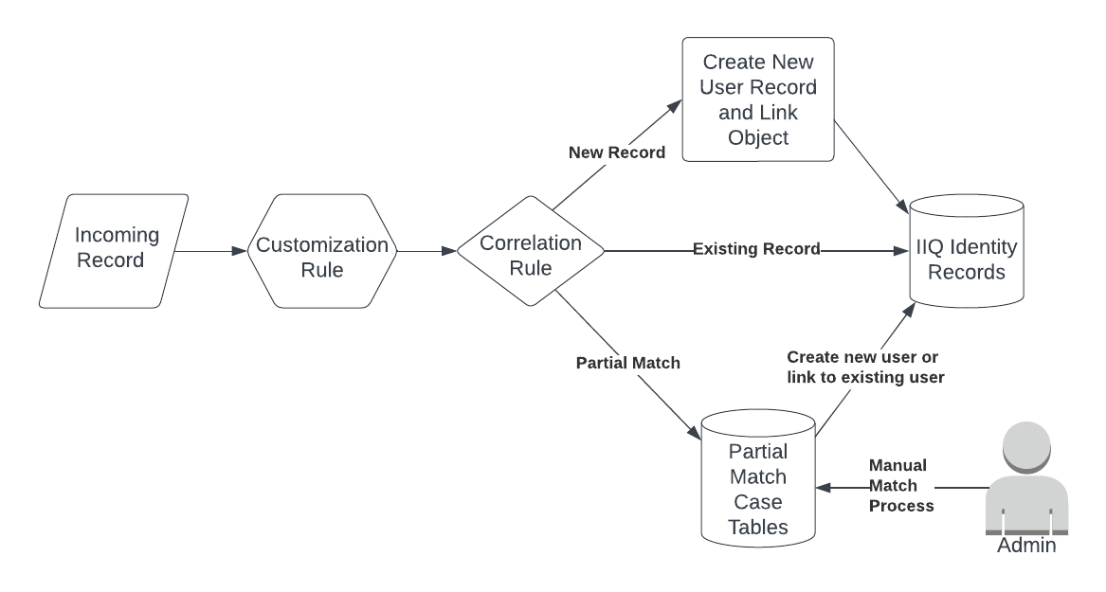
High Level Flow Diagram

Slide 7
The Environment
Sources (each with unique internal identity attribute)
A Student Information System Database
An Employee (Faculty/Staff) Database
An Alumni Database
Common Attributes used for matching logic
Name fields, gender identification, birthday, SSN (if available), university ID
University ID is immutable id assigned by Sailpoint, may be entered with source record as a means of bypassing matching rules if known
These common attributes will be represented in named link attributes to facilitate the matching logic

Slide 8
Correlation and Customization Rule
Correlation rule will be very similar for each authoritative source
Each rule will normalize data if necessary and call a common match routine in the plugin
Each invocation of the correlation rule will result in a positive match to an identity object
Existing identity object with pre-existing link object
Existing identity object being newly assigned the link object
Newly created identity being assigned link object
Newly created Partial Match identity object to temporarily hold link object
Customization rule is used to force population of named link attributes at the time of creation and update.

Slide 9
Example: Plugin High Level
The plugin performs the following functions
Engine for parsing matching rules stored in custom objects and performing matching logic when invoked from correlation rule, UI, or scheduled task
Manages IdentityIQPlugin schema tables to store metadata around partial matches
Provides User Interface for administrators to review, delegate, notate, and ultimately finalize partial match cases by assigning to existing identities or creating new identities
Contains scheduled tasks to perform cleanup, re-aggregation, and re-matching of partial match cases
Provides various rights and capabilities required to access these functions

Slide 10
Plugin: Match Logic
Matching rules stored in customization objects
Two kinds of rules: match and partial
Outcomes
Complete Match
If existing link object matches on source unique identifier
If one and only one identity matches on one or more match rules
But not if that identity already has a link object of that type
Partial Match
If link matches to a user who already has a link object of that type
If link matches more that one user on match rules
If link matches any users on partial match rules
If we have gone through the above without any matches, it results in the creation of a new identity

Slide 11
Plugin: Match Logic example
Match Rules
SSN / FirstName / Birthday / Gender
SSN / FirstName / MiddleName
SSN LastName
Partial Match Rules
FirstName / Birthday
LastName / MiddleName / Birthday
LastName / FirstName
SSN

Slide 12
Plugin: Partial Match Handling
Plugin classes to interpret and apply matching rules
Callable from Correlation rules, UI, remote API, etc.
Several outcomes handled by this code:
Matches to existing identity
Creates a new identity and matches to it
Creates a temp identity and matches to it
Also creates partial match table entries and assigns to a workgroup
Goal is to be configurable from custom objects
Audit events created for various operations along the way

Slide 13
Plugin: Partial Match Data Storage
Partial matches result in IIQ Identities created as temporary placeholders for the source link object
Additional metadata stored in custom IdentityIQPlugin tables
Match case name (ID) assigned and stored with with object type, linked temp identity, native identity, json blob containing all attributes, possible matches, rules invoked to create partial match, exceptions, etc.
Match assignment tables (matches can be assigned to teams or individuals with proper ACLs at the case and attribute level as necessary)
Match notes
Match history
Data could be forced into the identity object, but this allows it to persist after the match is closed for forensics and/or match “undo” purposes.

Slide 14
Plugin: User Interface
Custom UI provided by plugin to support searching, viewing, and resolution of partial match cases
Design goals
Present account administrator with enough information to make decisions
Deep links to more information as necessary (identity records, link object data history
Allow for fast searching / navigation / resolution
Allow for delegation based on automated assignment logic and manual re-assignment
Retain historical/audit information on previous operations/decisions
Retain IIQ UI Look and feel

Slide 15
Plugin: User Interface - Searching

Slide 16
Plugin: User Interface – Matching

Slide 17
Plugin: Scheduled Tasks
Re-Aggregate Partial Matches
Force re-evaluation of matching logic
New/changed users may produce different outcomes
Optimized source aggregations means re-evaluation will not occur naturally if source data does not change
Clean up temporary identities after match resolution
Clean up partial match tables
Configurable history
Reports generation
Outstanding partial match metrics by team for example

Slide 18
Further Enhancements
Fine grained ACL on UI
Sensitive attributes hidden from those without permissions
Automatic partial match case assignment based on source, match type, link attribute data
For example: VIP levels may be routed to special processing queue
Matching rules analysis
Once enough data gathered, rules can be evaluated, and suggestions made
Standardize matching rule logic to be configurable entirely by custom objects
External calls to fuzzy matching engines, machine learning engines, dare I say….AI? ☺

Slide 19
Thank you!

