Slide 1
IdentityIQ SCIM APIs
speaker: Firstname Lastname; title: Title; company: Name;

Slide 2
Agenda
Before you begin | Adam
Accessing the APIs | Adam
Standard API | Adam
SCIM API | Adam
Demo | Adam
Additional Resources | Adam

Slide 3
Agenda
Before you begin…
Accessing the APIs
Standard API
SCIM API
Custom API
Demo
Additional Resources

Slide 4
Before you begin…
IdentityIQ API’s are all REST-based (Representational State Transfer)
Data returned by the IdentityIQ API’s are in JSON (JavaScript Object Notation)
Data sent to the IdentityIQ API’s (PUT/PATCH/POST) will also be JSON
These are extremely popular standards, and almost every programming language will have libraries to make these calls easier
Having a go-to, easy to use REST client will make developing integrations much easier (ex. Postman)
Basic and Oauth 2.0 (Client Credentials) are the two available mechanisms to access the APIs – more on this later
Familiarize yourself with:
REST
JSON
OAuth

Slide 5
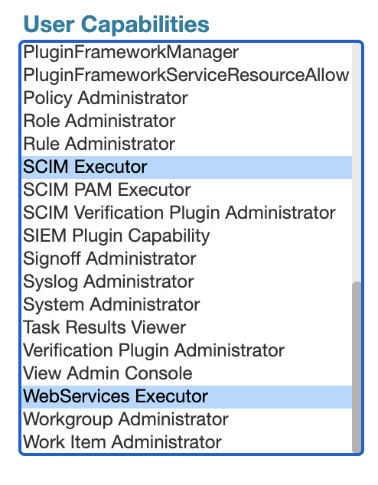
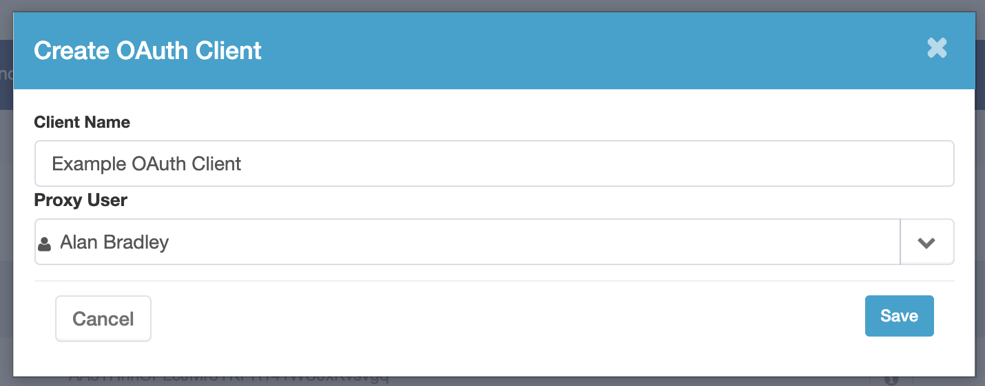
Accessing the APIs
Authentication is either Basic or Oauth (Client Credentials)
Authorization is done via proxy user and assigned Capabilities/SPRights

Slide 6
Standard REST APIs
Base URL - https://democorp.com/identityiq/rest
GET /ping
GET /authentication
GET /configuration
GET /policies/checkRolePolicies
POST /policies/checkPasswordPolicies
GET /roles/assignablePermits
GET /identities
POST /identities
PUT /identities
GET /identities/<name>/managedIdentities
GET /identities/<name>/checkAuthorization
POST /identities/<name>/aggregate
GET /identities/<name>/links
POST /workflows/<name>/launch
GET /taskResults/<name>/status
POST /taskResults/<id>/cancelWorkflow
POST /passwordIntercept
IIQClient
Java class designed to streamline integration with the standard REST API’s
Contains methods for each available endpoint/operation
Example:
Public ListResult getLinks(String identityName, Boolean includeLinkState)

Slide 7
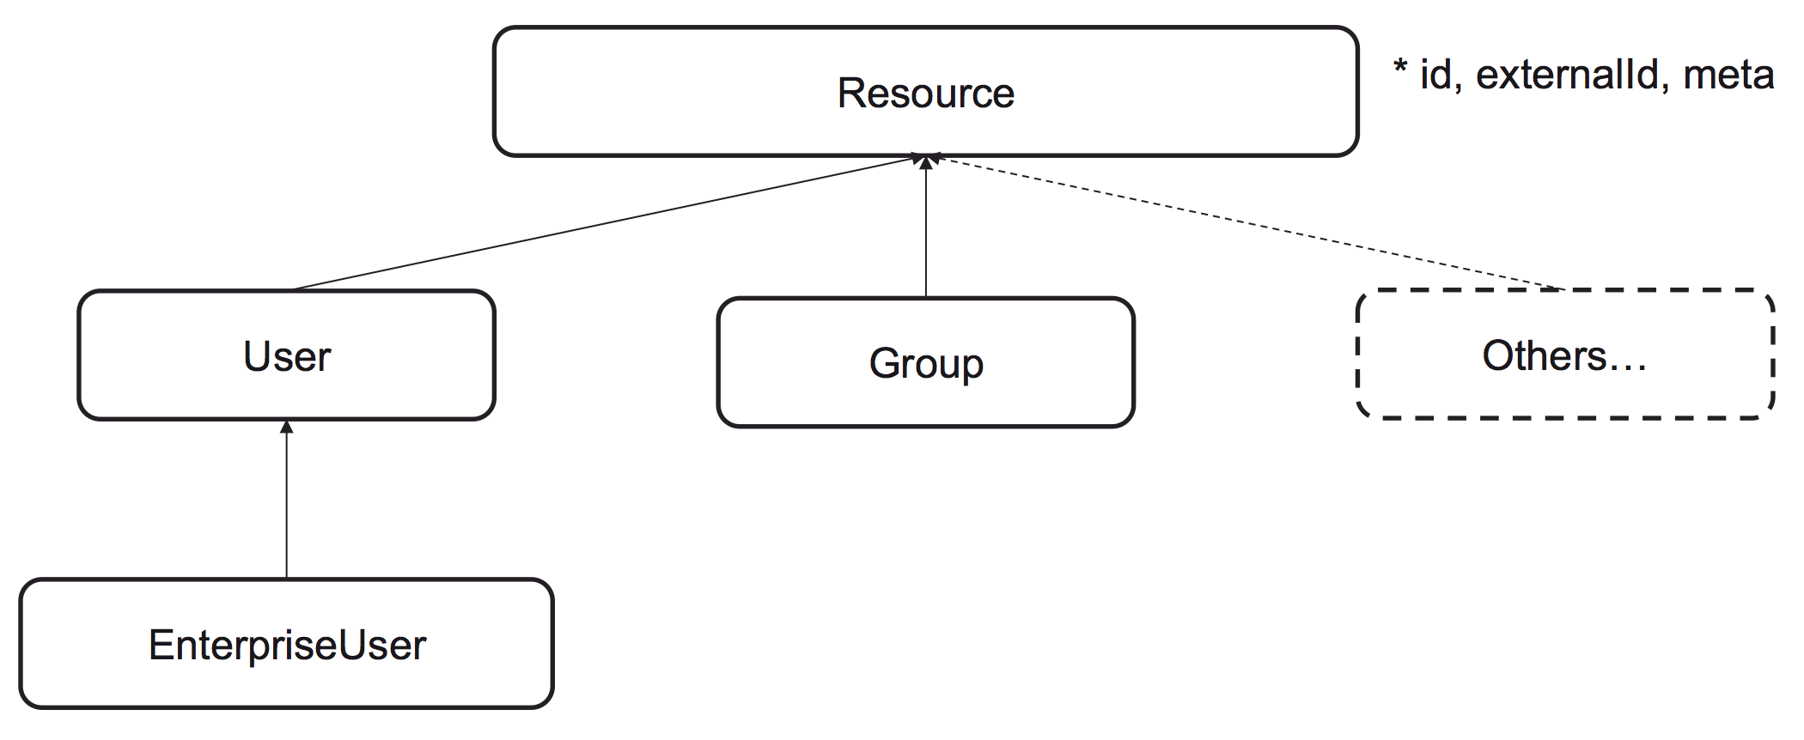
SCIM APIs
Base URL - https://democorp.com/identityiq/scim/v2
GET/POST/PUT/DELETE /Accounts
GET/POST /Alerts
GET /Applications
POST /CheckedPolicyViolations
GET /Entitlements
GET/POST /LaunchedWorkflow
GET /ObjectConfigs
GET /PolicyViolations
GET /ResourceType
GET /Roles
GET /Schemas
GET /ServiceProviderConfig
GET /TaskResults
GET/POST/PUT/DELETE /Users
GET /Workflows
http://www.simplecloud.info/

Slide 8
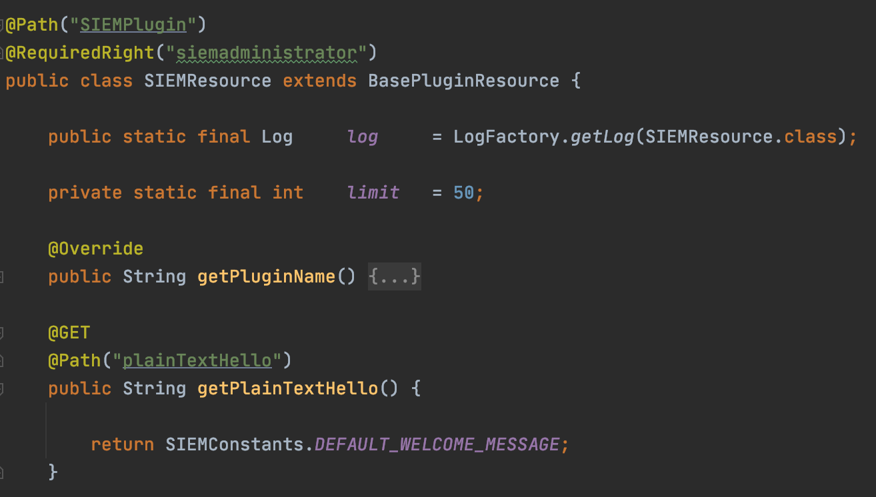
Custom APIs
The IdentityIQ Plugin framework can be used to create custom APIs if/when required.
Base URL - https://democorp.com/identityiq/plugin/rest/<pluginName>/customEndpoint
Guide to Plugin development available on Compass with examples of this…

Slide 9
Demo: Launching a Workflow

Slide 10
Additional Resources
SailPoint Developer Portal – https://developer.sailpoint.com
REST API - https://community.sailpoint.com/t5/Technical-White-Papers/IdentityIQ-REST-API-Integration/ta-p/76814
SCIM API – https://developer.sailpoint.com/apis/iiq/
SCIM Protocol – https://datatracker.ietf.org/doc/html/rfc7644
SCIM Core Schema - https://datatracker.ietf.org/doc/html/rfc7643
Plugin Developer Guide – https://community.sailpoint.com/t5/Plugin-Documents/Plugin-Developer-Guide/td-p/79347

Slide 11
Thank you!

