Slide 1
Object-Oriented-Programming (OOP) Approach in Plugin Development
Speaker: Yu-Chih Chung (Mike); title: Senior Solution Consultant, CISSP, SailPoint Certified IdentityIQ Architect; company: KOGIT GmbH;

Slide 2
Agenda
Who are we? | Self Introduction
Plugin Development Challenge: No Hibernate for OOP | Problem Introduction
The Magical Generic Data Access Object (DAO) | Our Solution
Development Environment Setup | IDE Setup
Absence Management Plugin | Live Demo
Question & Feedback | Q&A

Slide 3
Who are we?
Self Introduction

Slide 4
A Europe-wide recognized and leading consulting firm, we aim to develop secure and innovative solutions for customized Identity and Access Management (IAM).

Slide 5
KOGIT Services
Identity Management
Structured and transparent management of identities
Access Management
Which identity accesses what IT systems
Compliance
Regulatory compliance through credential monitoring, analysis & periodic recertification.
Privileged Access Management
Protect privileged user accounts & access rights from data breaches through efficient control
Security Information & Event Management
Collection & analysis of messages and log files, real-time detection of potential threats
Advanced Analytics
Identify risks of unauthorized data access/theft at an early stage & initiate defensive measures

Slide 6
Plugin Development Challenge: No Hibernate for OOP
Problem Introduction

Slide 7
No Hibernate for OOP
Plugin Framework
Java Application
In Plugin Development, the inability to invoke custom Hibernate configurations into IIQ forces developers to resort to using PluginBaseHelper for direct SQL queries, which complicating development and maintenance.
The variation in SQL queries required for different operations and database types gives it more challenges.
Persistent Object
Hibernate Properties
Session Factory
Session
PluginBaseHelper + SQL Query
Transaction
Query
XML Mapping
Object Relational Mapping (ORM)
JDBC

Slide 8
The Magical Generic Data Access Object (DAO)
Our Solution

Slide 9
Generic Data Access Object (DAO)
Abstract
Database Variants
CRUD
Abstracting the data access layer from/to external databases.
Developers focus on defining the data model and employing object-oriented programming (OOP) through standard BeanShell code
Developers are now relieved from constructing complex SQL queries for different database solutions (e.g., MySQL, Oracle, MSSQL)
Support on diverse operations: Create/Read/Update/Delete and Search plus Filtering.
Reusable Framework for newly introduced object class.
Reducing development and maintenance efforts in subsequent cycles

Slide 10
Generic Data Access Object (DAO)
Abstract
Database Variants
CRUD
Abstracting the data access layer from/to external databases.
Developers focus on defining the data model and employing object-oriented programming (OOP) through standard BeanShell code
Developers are now relieved from constructing complex SQL queries for different database solutions (e.g., MySQL, Oracle, MSSQL)
Support on diverse operations: Create/Read/Update/Delete and Search plus Filtering.
Reusable Framework for newly introduced object class.
Reducing development and maintenance efforts in subsequent cycles

Slide 11
Generic Data Access Object (DAO)
Abstract
Database Variants
CRUD
Abstracting the data access layer from/to external databases.
Developers focus on defining the data model and employing object-oriented programming (OOP) through standard BeanShell code
Developers are now relieved from constructing complex SQL queries for different database solutions (e.g., MySQL, Oracle, MSSQL)
Support on diverse operations: Create/Read/Update/Delete and Search plus Filtering.
Reusable Framework for newly introduced object class.
Reducing development and maintenance efforts in subsequent cycles

Slide 12
Generic Data Access Object (DAO)
Abstract
Database Variants
CRUD
Abstracting the data access layer from/to external databases.
Developers focus on defining the data model and employing object-oriented programming (OOP) through standard BeanShell code
Developers are now relieved from constructing complex SQL queries for different database solutions (e.g., MySQL, Oracle, MSSQL)
Support on diverse operations: Create/Read/Update/Delete and Search plus Filtering.
Reusable Framework for newly introduced object class.
Reducing development and maintenance efforts in subsequent cycles

Slide 13
Absence Management Plugin
Live Demo

Slide 14
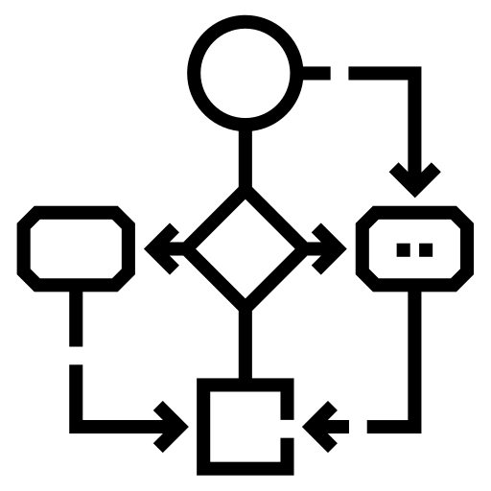
Demo: Absence Management Plugin
Plugin Database Table
& Data Model: Absence
Workflow Quick Link
Task: Absence Executor
Define the table schema to store the absence request.
Define the data model for absence request, including start/end date, approved, reason and deputy.
A QuickLink workflow used as the interface for absence CRUD processes.
A task which scan through all absence requests and set up the Forward User for the absence requster.

Slide 15
Development Environment Setup
IDE Setup

Slide 16
Suggested Knowledge
Plugin Developer Guide | SailPoint Developer Community
SailPoint University: IdentityIQ Advanced Implementation: Plugins v8.3 - ELEARNING

Slide 17
Environment Setup
Eclipse + IIQDA
IIQ 8.2+ instance

Slide 18
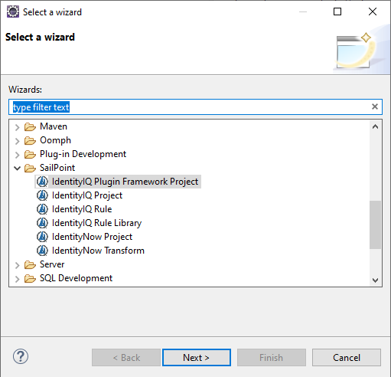
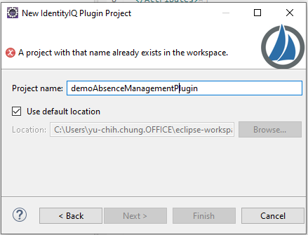
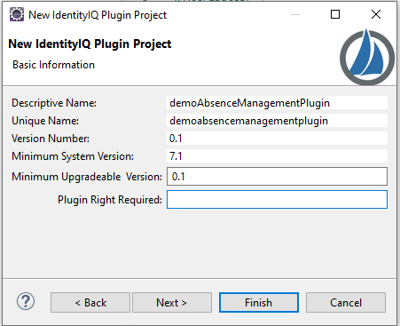
Initiate Plugin Framework Project
File > Other > IdentityIQ Plugin Framework Project
Delete files under import/ and db/

Slide 19
Coding Practice
Live Demo

Slide 20
Create Java Packages and Java Classes
Package | Java Class | Comment
demo.sailpoint.absence.plugin | Constants.java | provided
demo.sailpoint.absence.plugin.dao | DAO.java | provided
demo.sailpoint.absence.plugin.model | PluginDbField.java PluginDbTable.java PluginObject.java | provided
demo.sailpoint.absence.plugin.paginator | Paginator.java Sorter.java | provided
demo.sailpoint.absence.plugin.service | GenericService.java | provided
demo.sailpoint.absence.plugin.task | AbsenceExecutor.java | created
demo.sailpoint.absence.plugin.tools | DateTimeUtils.java PluginDifferencer.java PluginObjectHelper.java | provided

Slide 21
AbsenceExecutor.java

Slide 22
manifest.xml

Slide 23
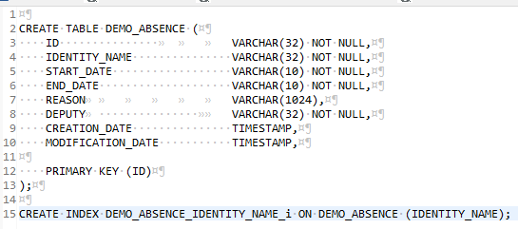
Task1: Define Table Schema install.oracle
An Absence may contain the below information:
IdentityName
Start Date
End Date
Reason
Deputy

Slide 24
Task2: Define Model Class: Absence.java
Under package: demo.sailpoint.absence.plugin.model
The class extends PluginObject
Define @PluginDbTable, @JsonProperty, @JsonInclude, @PluginDbField for each field
Generate Getter and Setter
Notes:
By define the annonations, we are telling the DAO class the mapping between persistent object and corresponding table and fields.

Slide 25
Task3: Define DAO Class: AbsenceDao.java
Under package: demo.sailpoint.absence.plugin.dao
The class extends DAO
Inherited functions: create(), updated() and delete()
Define get() and search() functions.

Slide 26
Task4: Define Service Class: AbsenceService
Under package: demo.sailpoint.absence.plugin.service
The class extends GenericService
Define createAbsence(), updateAbsence(), deleteAbsence(), getAbsence() and getAbsencesByIdentity()
Notes:
The GenericeService basically give a similar taste of JPA, which it execute the corresponding dao class method base on the method name.
Here we have getAbsence, which gives an example to directly call the dao class.
The getAbsenceByIdentity, demonstrate how can we use IIQ internal Filter object to search on the plugin table.

Slide 27
Task5: AbsenceExecutor
This class scan through all Absence entries.
Checking if it‘s an active Absence and if Identity does not yet have any forward preferences. Then configure the forward preference base on the absence information.

Slide 28
Sample Code: Create Absence
import demo.sailpoint.absence.plugin.model.Absence;
import demo.sailpoint.absence.plugin.service.AbsenceService;
Absence absence = new Absence(identityName, startDate, endDate, reason, deputy);
AbsenceService.createAbsence(context, absence);

Slide 29
Sample Code: Update Absence
import demo.sailpoint.absence.plugin.model.Absence;
import demo.sailpoint.absence.plugin.service.AbsenceService;
Absence absence = AbsenceService.getAbsence(context, id).get();
absence.setDeputy(deputy);
absence.setStartDate(startDate);
absence.setEndDate(endDate);
absence.setReason(reason);
AbsenceService.updateAbsence(context, absence);

Slide 30
Sample Code: Delete Absence
import demo.sailpoint.absence.plugin.model.Absence;
import demo.sailpoint.absence.plugin.service.AbsenceService;
import sailpoint.tools.Util;
Absence absence = AbsenceService.getAbsence(context, id).get();
AbsenceService.deleteAbsence(context, absence);

Slide 31
Sample Code: Get Absences by Identity
import demo.sailpoint.absence.plugin.model.Absence;
import demo.sailpoint.absence.plugin.service.AbsenceService;
List list = AbsenceService.getAbsencesByIdentity(context, identityName);

Slide 32
Create XML Artifacts
Object Type | Name
QuickLink | DEMO Create Absence
QuickLink | DEMO Update Absence
QuickLink | DEMO Delete Absence
Workflow | DEMO Create Absence
Workflow | DEMO Update Absence
Workflow | DEMO Delete Absence
TaskDefinition | DEMO Absence Executor

Slide 33
Ant Build: Plugin ZIP File Content
Use Eclipse to execute Ant build with target package.
The compiled package (.zip) is under build/ folder.

Slide 34
Question & Feedback
Q&A

Slide 35
Thank you!

